Slide 1
Configure AWS for Back End

Slide 2
Set Up AWS for Java Back End

Slide 3
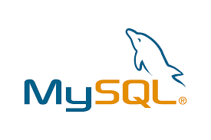
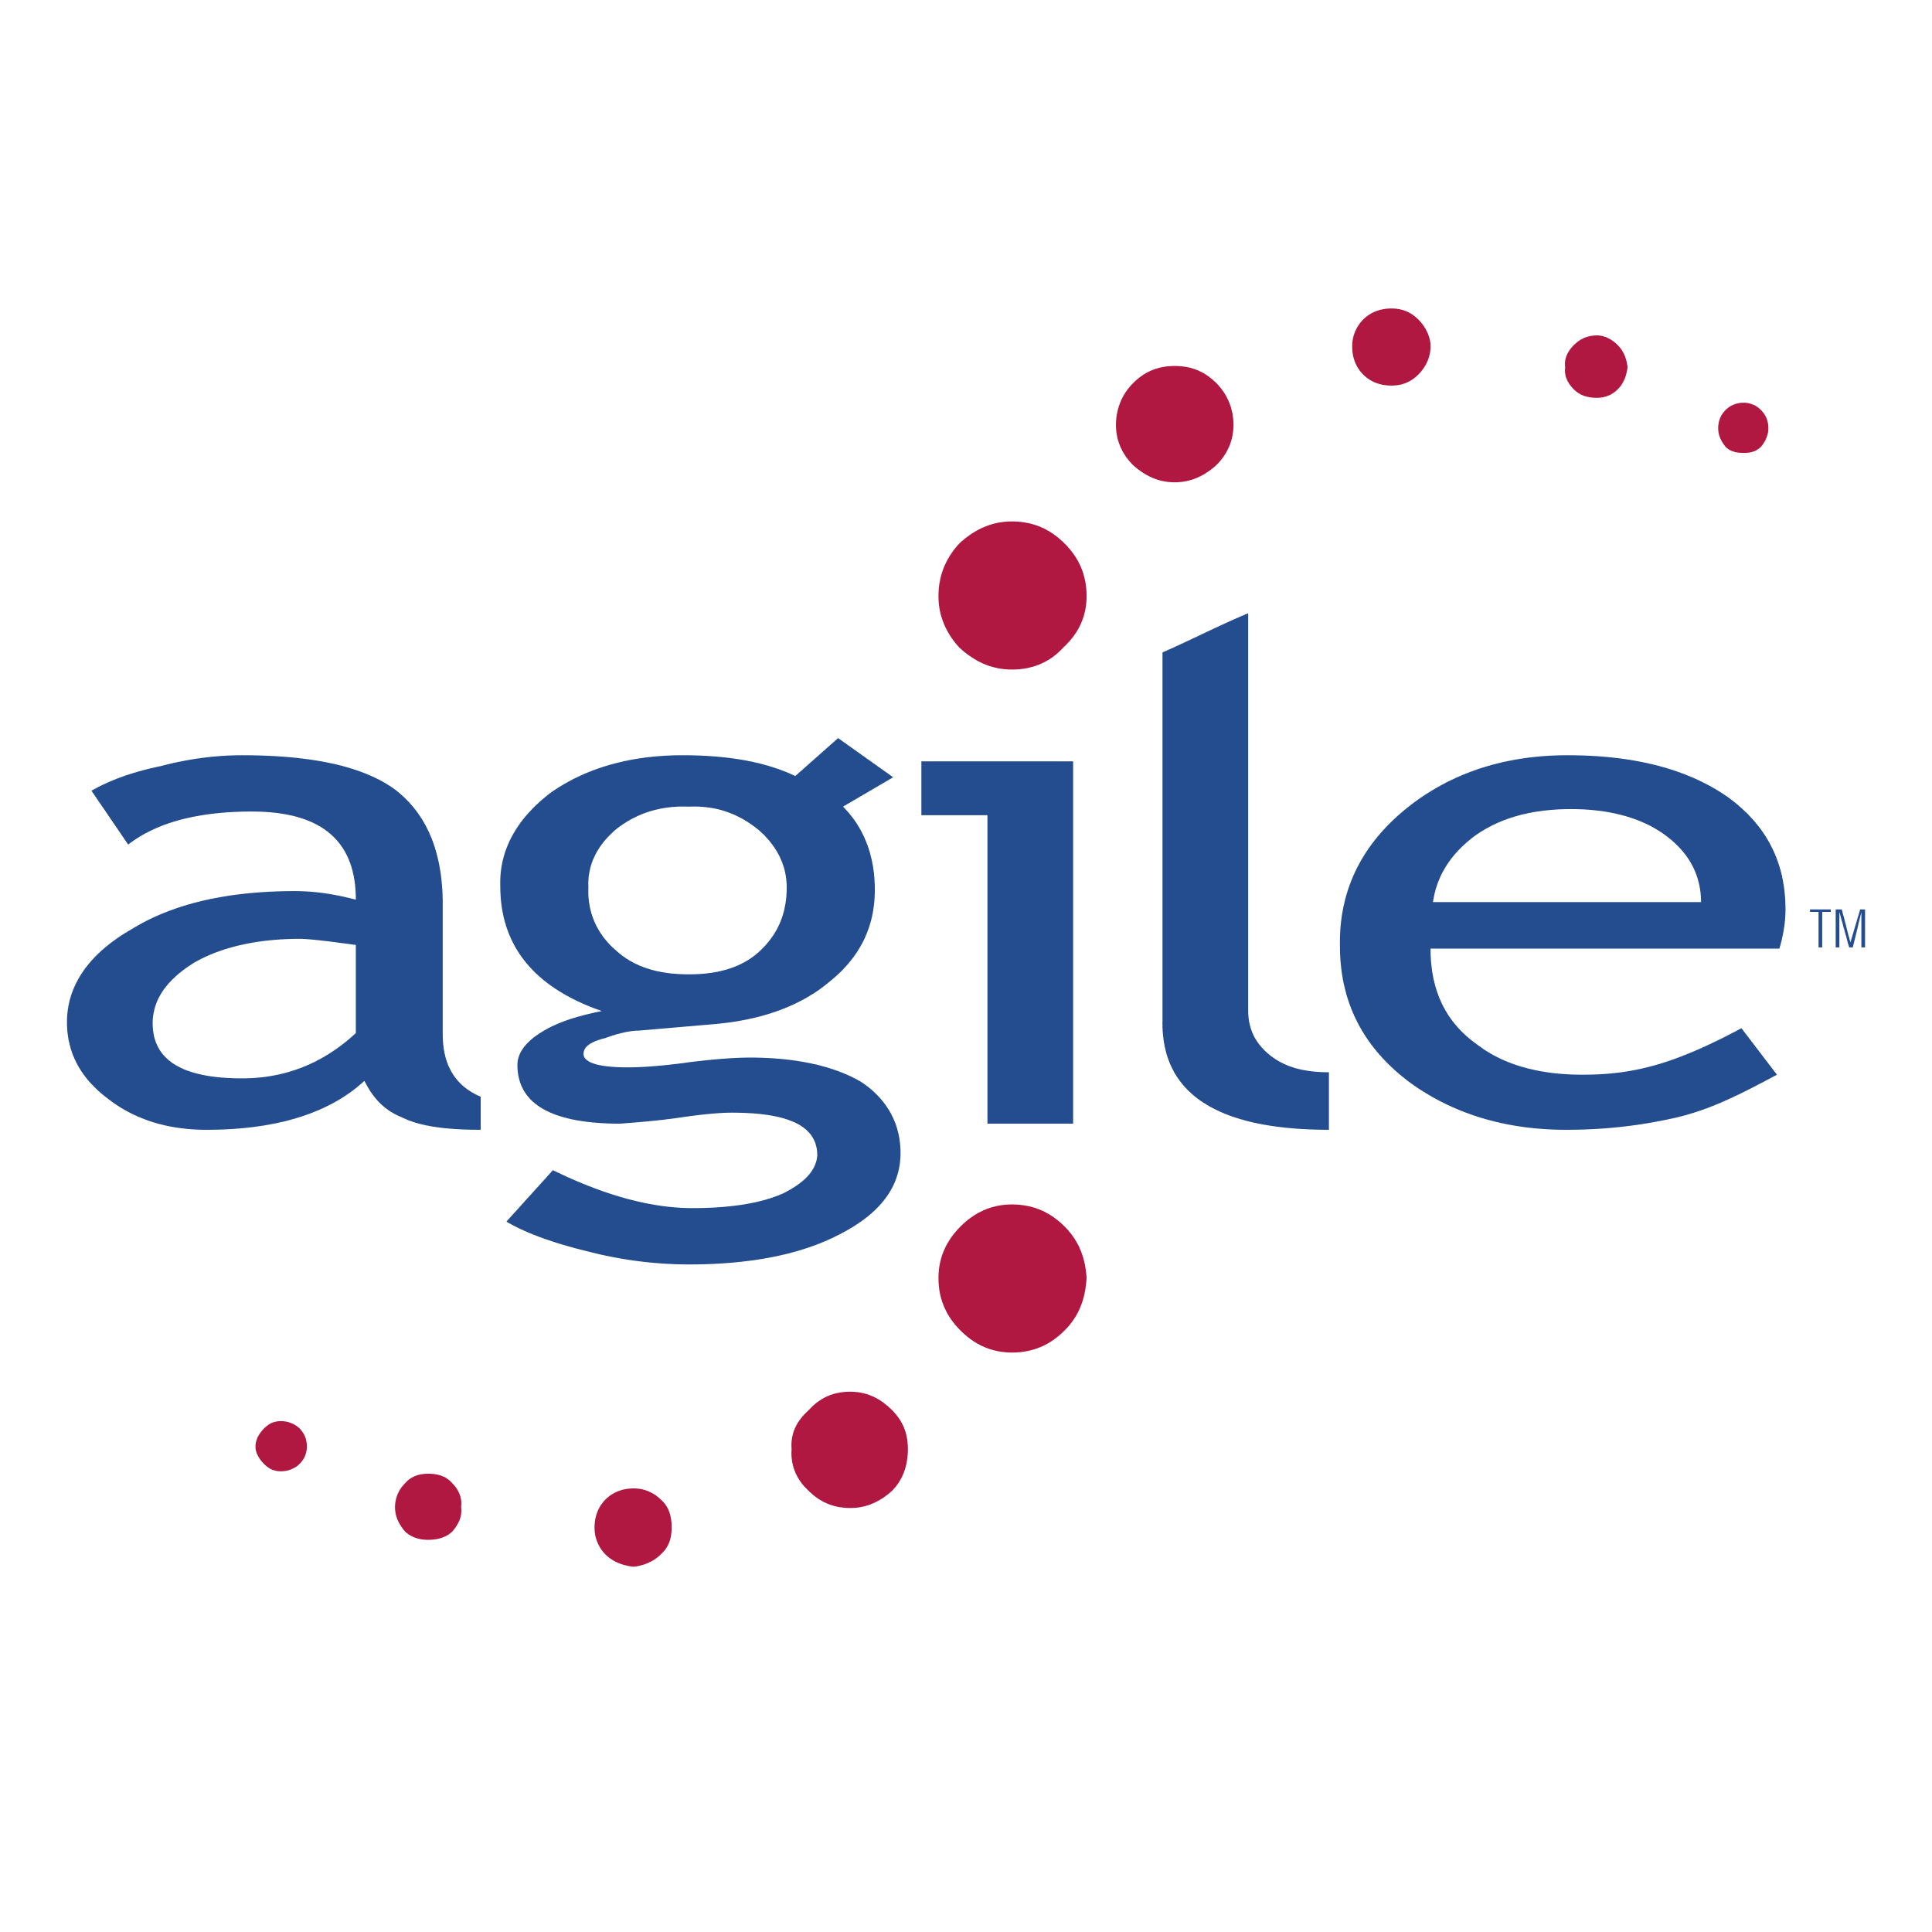
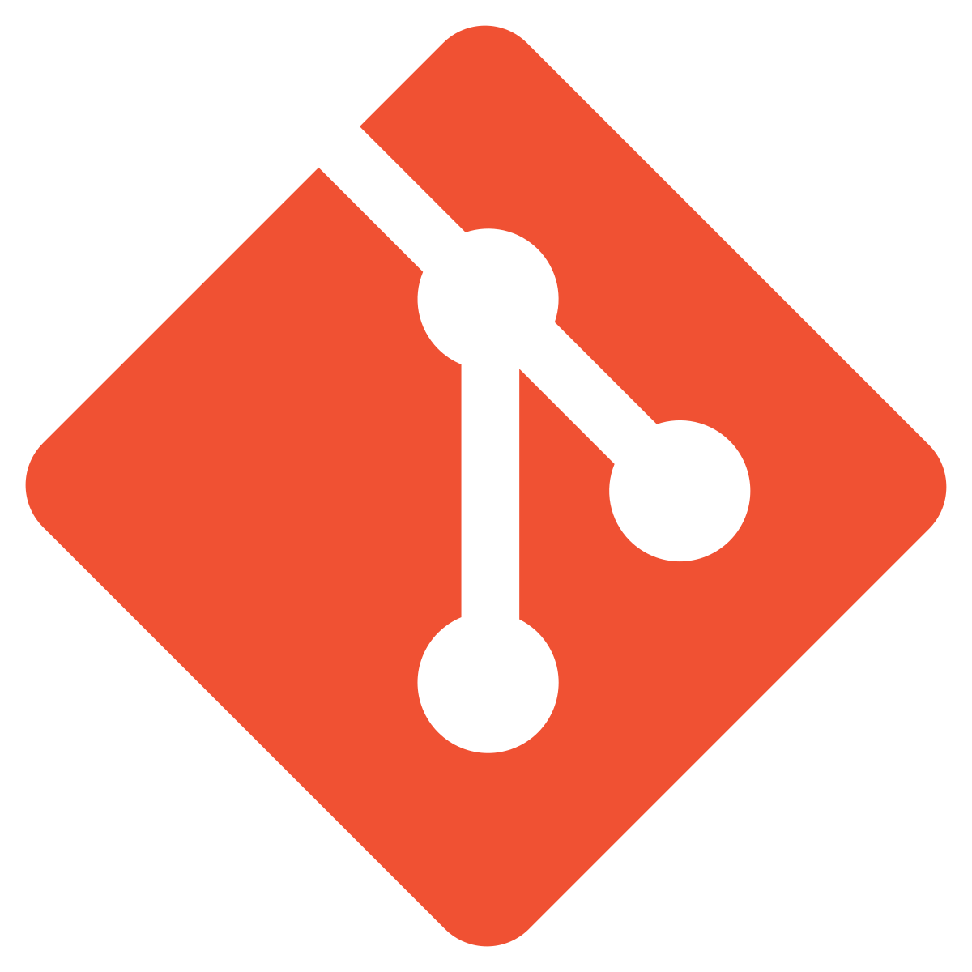
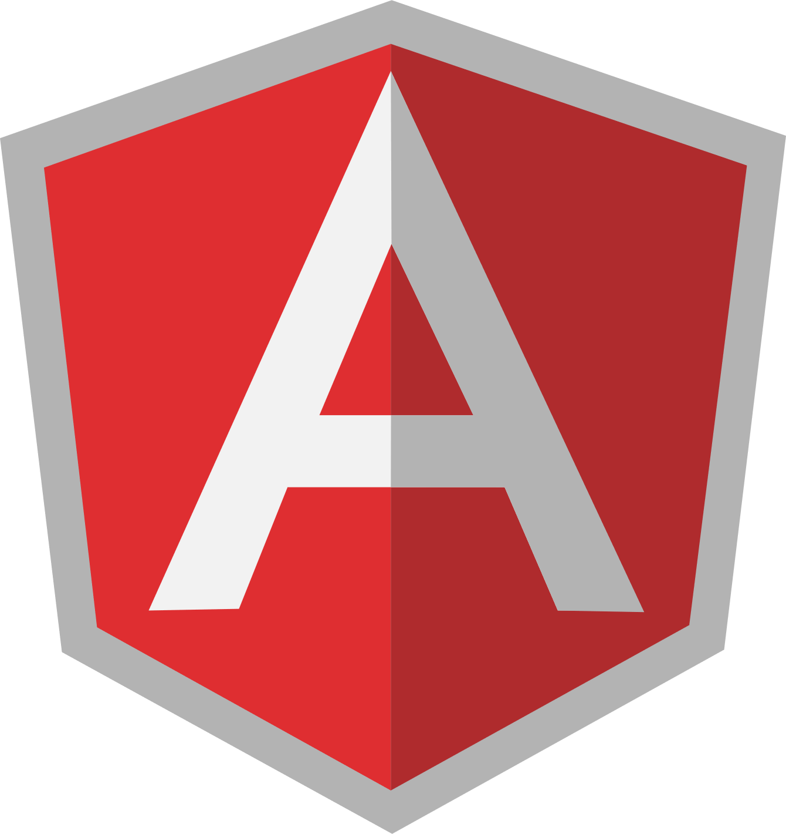
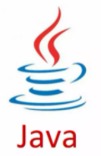
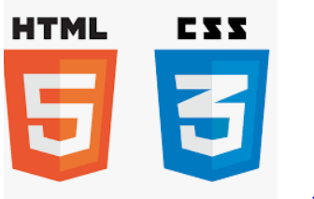

Before we begin, let’s recall what we have covered till now:
Agile
Git
SQL
Angular
HTML
CSS
JavaScript
CoreJava

Slide 4
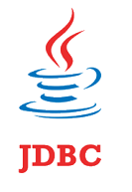

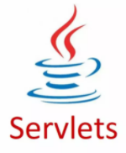


Before we begin, let’s recall what we have covered till now:
JDBC
JSP
Servlets
MongoDB
Maven

Slide 5

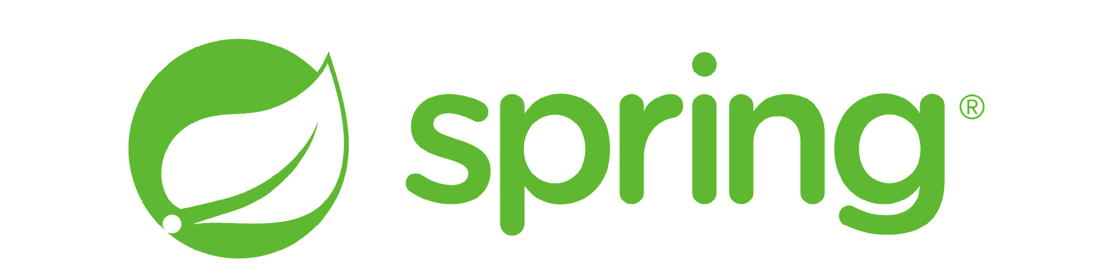
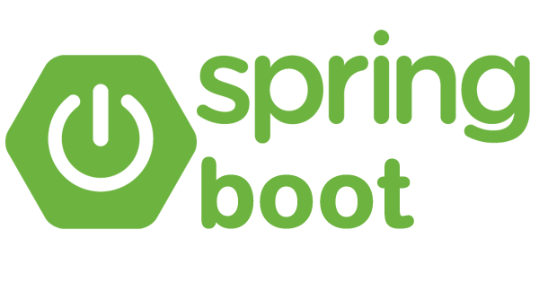
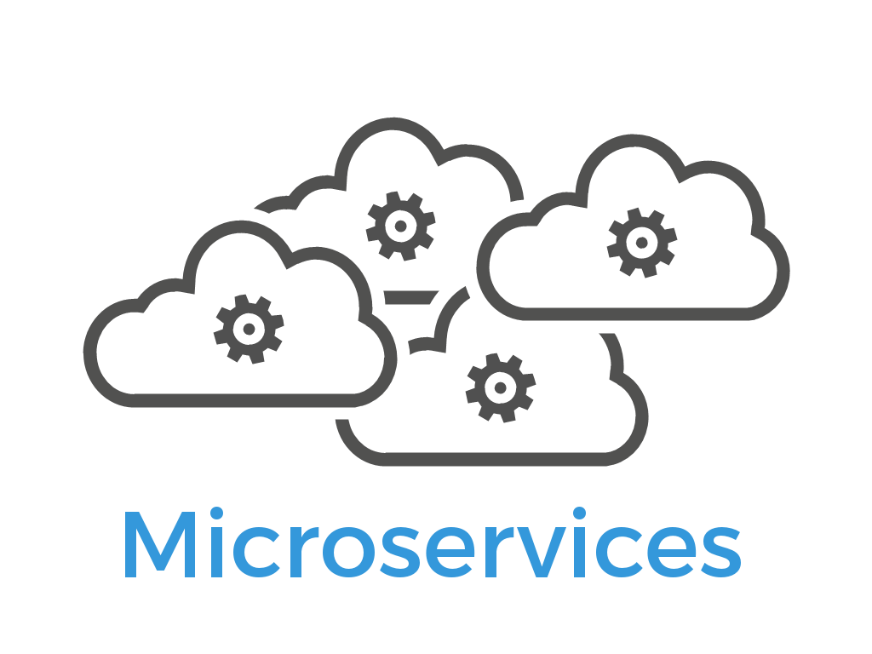
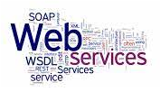
Before we begin, let’s recall what we have covered till now:
JUnit
Spring
Spring Boot
Webservices
Microservices

Slide 6
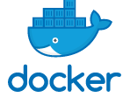
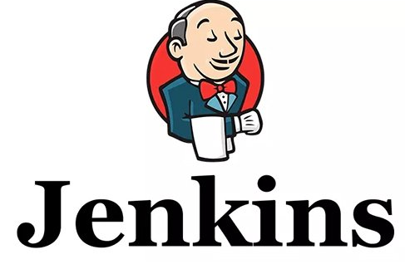

Before we begin, let’s recall what we have covered till now:
Docker
Jenkins
AWS

Slide 7
Front-End Backend Communication
Used HTTP Client in Angular to communicate with Java back end
Implemented communication for both admin and end-user projects
Jenkins Pipeline
Used Jenkins build automation server to build angular apps and Java back end
Created Pipeline with multiple stages

Slide 8
Docker
Used Docker to build images for Angular apps and Java back end
Used Jenkins to dockerize the Angular apps and Java back end with Jenkins
Configure Angular Apps on EC2
Created and configured EC2 instance for Angular apps
Ran Jenkins pipeline to dockerize the Angular apps and deploy them

Slide 9
As a full stack web developer, our key role is to develop both client and server software.
Angular and Node can be used to build front end of the web page.
Spring Boot, Java, and MySQL or MongoDB can be used to build at the back end.

Slide 10

Bob needs to configure AWS for Front end. He brainstorms a bit and finds a solution.
Let me use Jenkins, Docker, and AWS to build CI/CD Pipelines, containerize the apps, and finally host them to AWS EC2 instance.
In this lesson, we will host the Java Backend app on EC2 instance, use Jenkins and Docker as DevOps tools to make it live and help Bob to complete his task effectively and quickly.

Slide 11

Explain the steps to create and configure EC2 instance on AWS
Discuss the steps to create MySQL RDS database on AWS
Understand the use Jenkins on EC2 for CI/CD
Discuss how to integrate Docker in Jenkins to build and release the images as containers on EC2

Slide 12
Create and Configure EC2 in AWS

Slide 13
Amazon Web Services
Amazon Web Services (AWS) is a cloud platform, which offers more than 200 fully featured services.
Angular web apps on EC2 instance is deployed using Jenkins and Docker.
Notes:
Amazon Web Services (AWS) is a cloud platform, which offers more than 00 fully featured services.
We are now in the last phase of our project, where we will deploy the apps on AWS.
Now, we will deploy the Java Backend on EC2 Instance using Jenkins and Docker.

Slide 14
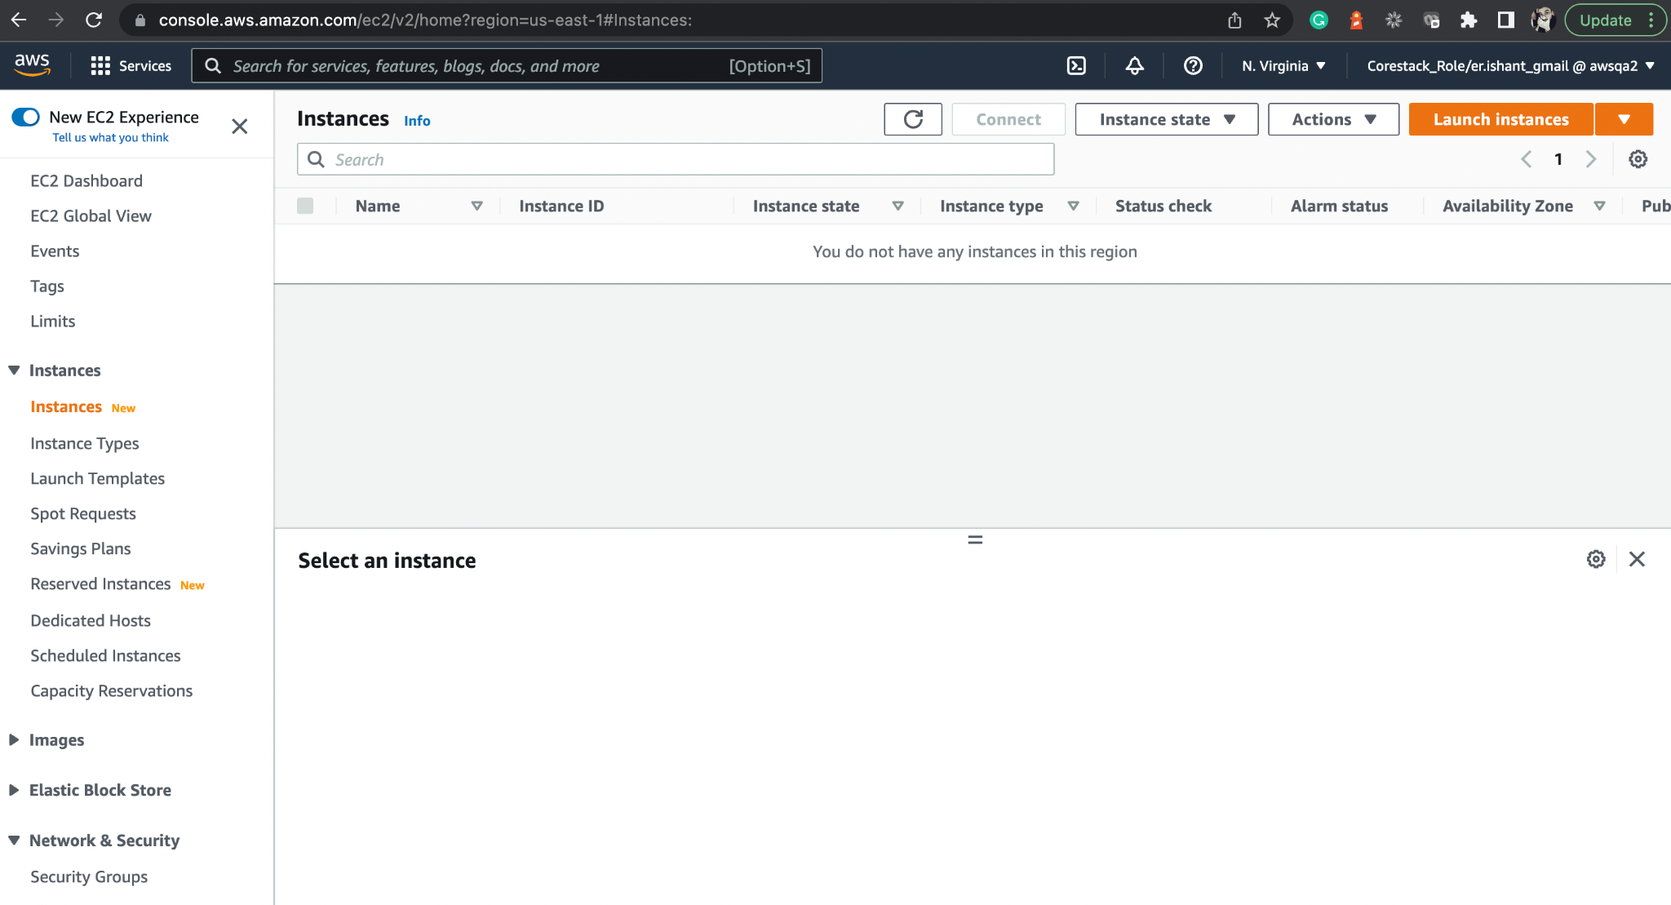
Create EC2 Instance
Open the EC2 dashboard.
Notes:
Open the EC2 dashboard.

Slide 15
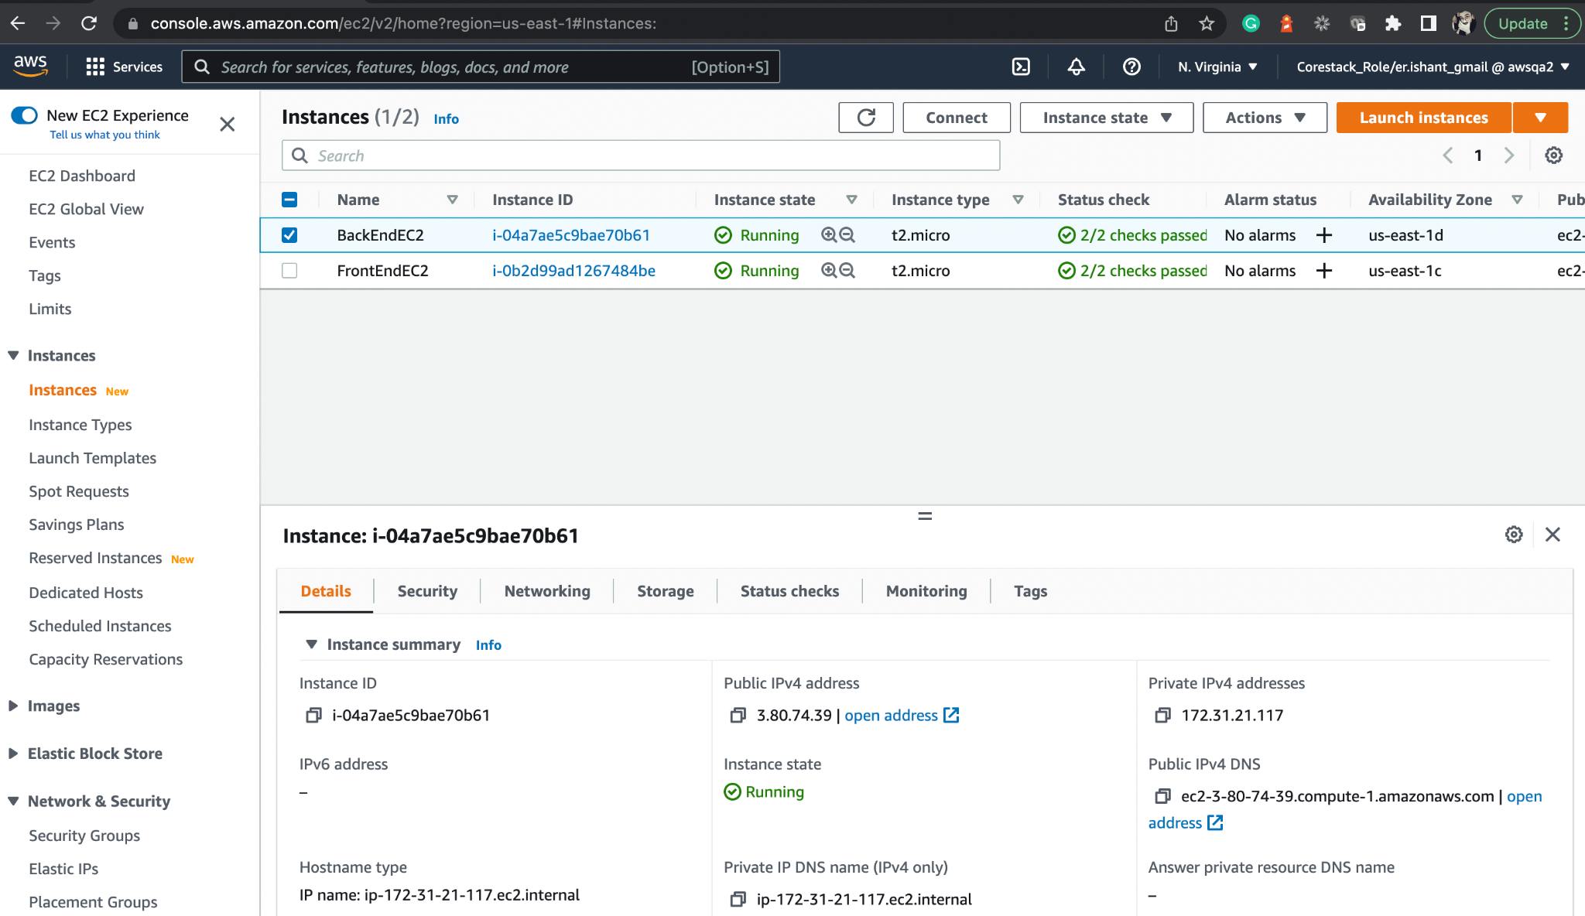
Launch Instance
Launch a new instance.
Create service group and key pair to access the instance from terminal.
Use the AWS Cloud Shell to perform the tasks.
Notes:
Launch a new Instance.
As a prerequisite, you must create your service group and key pair so as to access the instance from your terminal.
For this, lab we will use the AWS Cloud Shell itself to perform the tasks.
We will have 2 EC2 Instance now, 1 for Front End and a newly created for backend

Slide 16
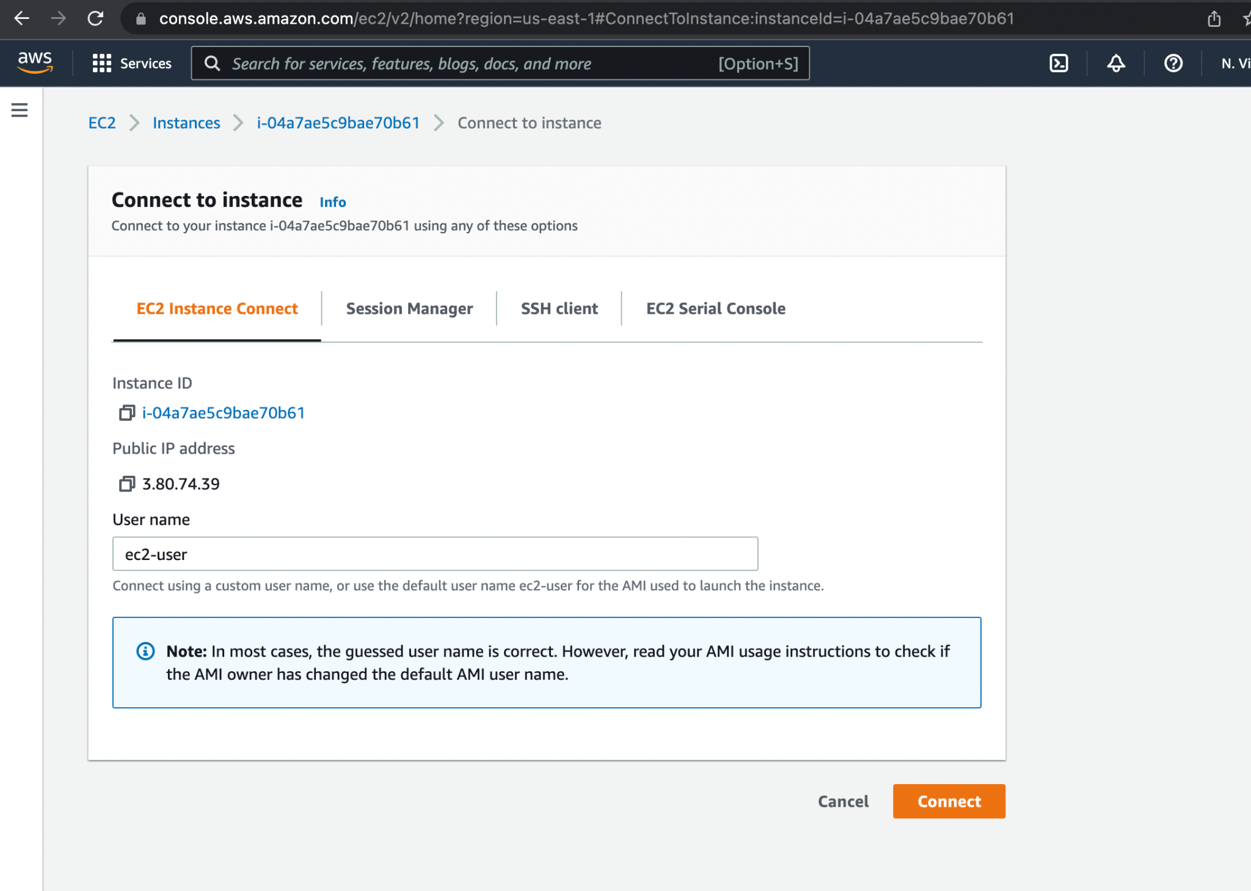
Connect to EC2 Instance
Connect through AWS Cloud Shell, which is the first option on clicking connect, that is EC2 Instance Connect.
Connect using one of the various methods, like ssh.
Notes:
You can connect using one of the various methods, e.g.: ssh
But here, we will connect through AWS Cloud Shell itself which is the 1st option when you click on connect i.e. EC2 Instance Connect

Slide 17
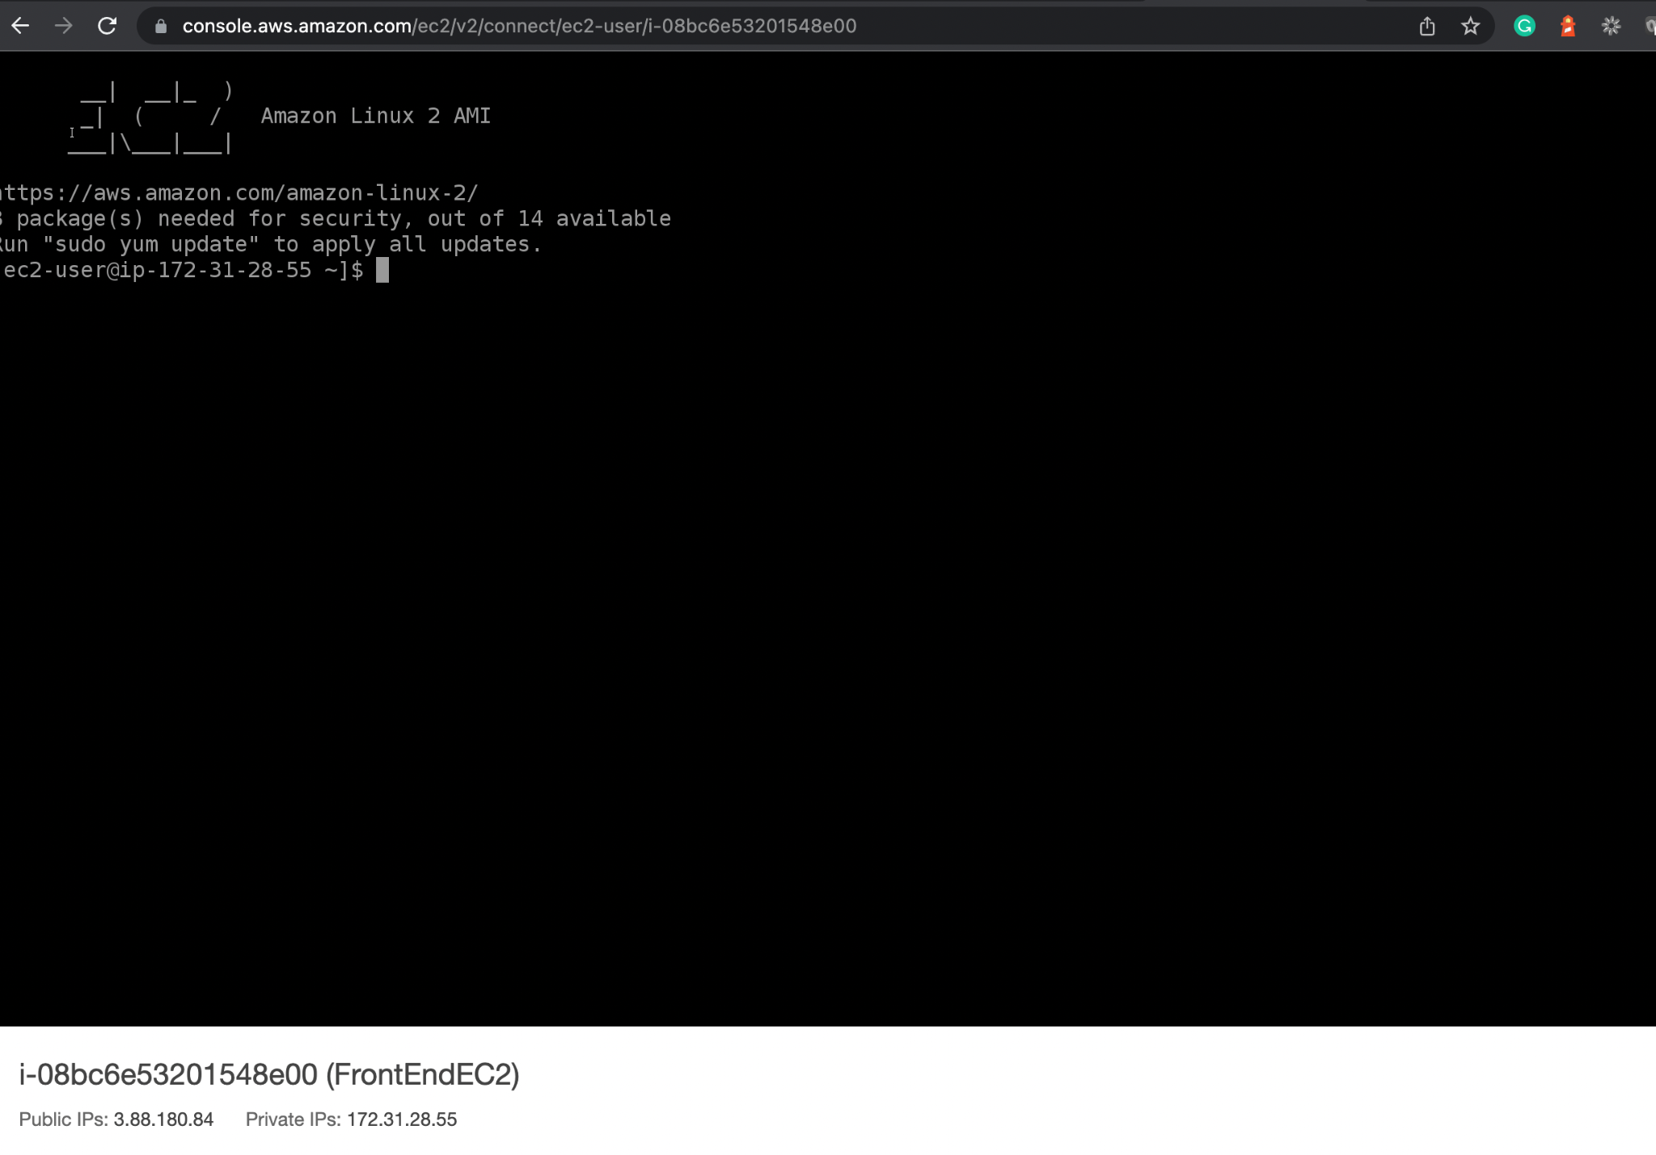
Launch the EC2 Shell and Configure the Tools
Install the tools and software required to deploy Angular apps and configure Node, Git, Docker, and Jenkins.
Notes:
Now, let’s install the tools and software required to deploy our Angular Apps.
We will configure Node, Git, Docker and Jenkins now.

Slide 18
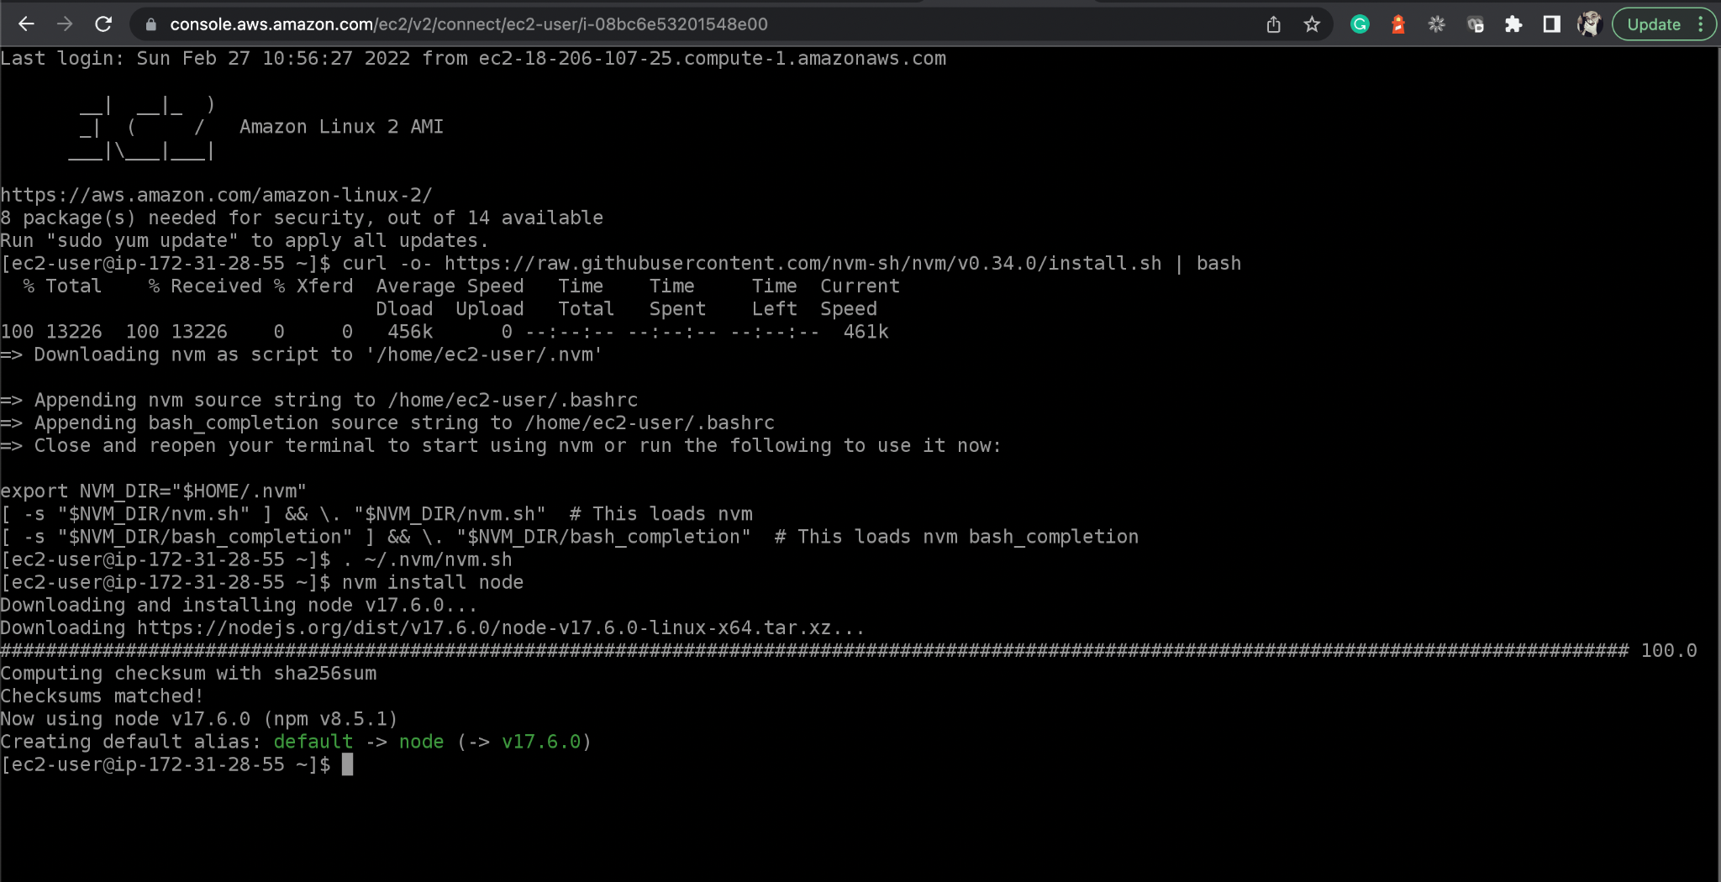
Configure Node on EC2
Configure the Jenkins Pipeline Project by passing GitHub repository URL.
Reference link on AWS documentation: https://docs.aws.amazon.com/sdk-for-javascript/v2/developer-guide/setting-up-node-on-ec2-instance.html
Notes:
Configure the Jenkins Pipeline Project by passing GitHub Repository URL
Reference Link on AWS Documentation: https://docs.aws.amazon.com/sdk-for-javascript/v2/developer-guide/setting-up-node-on-ec2-instance.html

Slide 19
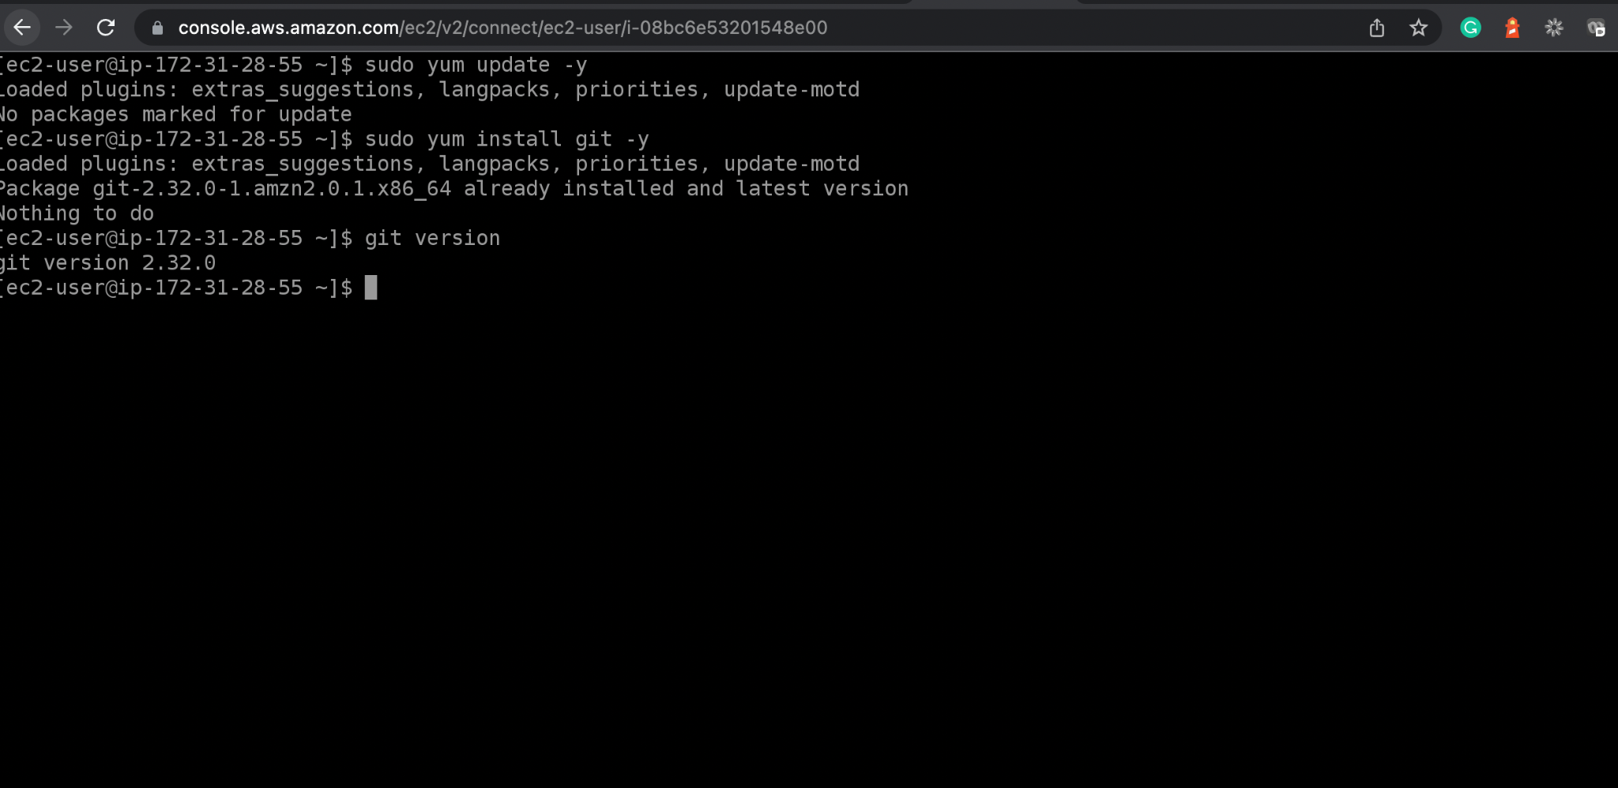
Configure Git on EC2 Instance
Configure Git on EC2 Instance.

Slide 20
Configure Java on EC2 Instance
Use the following commands to install Java:
Install JDK 8
sudo yum update -y
sudo yum install java-1.8.0-openjdk
Install JDK 11 - Java
sudo amazon-linux-extras install java-openjdk11
Notes:
Use the following commands to install Java:
# Install JDK 8
sudo yum update -y
sudo yum install java-1.8.0-openjdk
# Install JDK 11 - java
sudo amazon-linux-extras install java-openjdk11

Slide 21
Configure Java on EC2 Instance
Use the following commands to install Java:
Install JDK 11 Development - javac
sudo yum install java-11-openjdk-devel
Configure Java Version 8 or 11
sudo alternatives --config java
Notes:
# Install JDK 11 Development - javac
sudo yum install java-11-openjdk-devel
# Configure Java Version 8 or 11
sudo alternatives --config java

Slide 22
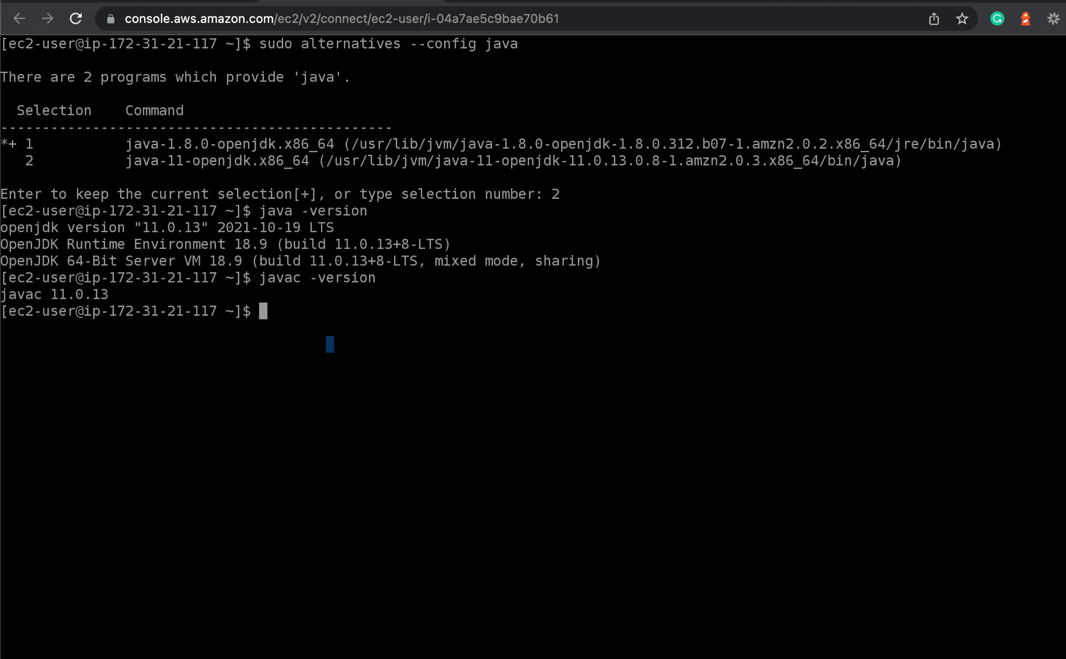
Configure Java on EC2 Instance

Slide 23
Configure Docker on EC2 Instance
Now, install Docker for containerizing the Angular apps. Here are some useful commands:
1
Install Docker:
sudo yum install docker
2
Add the ec2-user to the docker group to execute Docker commands without using sudo, exit the terminal, and re-login to make the change effective.
sudo usermod -a -G docker ec2-user
exit
Notes:
Now, let us install Docker for containerizing the angular apps.
Here are some useful commands:
Install Docker.
sudo yum install docker
Add the ec2-user to the docker group so you can execute Docker commands without using sudo and Exit the terminal and re-login to make the change effective
sudo usermod -a -G docker ec2-user
exit
Enable docker service
sudo systemctl enable docker
Start docker service
sudo systemctl start docker
Check the Docker service.
sudo systemctl status docker

Slide 24
Configure Docker on EC2 Instance
3
Enable docker service:
sudo systemctl enable docker
4
Start docker service:
sudo systemctl start docker
5
Check the docker service:
sudo systemctl status docker
Notes:
Enable docker service
sudo systemctl enable docker
Start docker service
sudo systemctl start docker
Check the Docker service.
sudo systemctl status docker

Slide 25
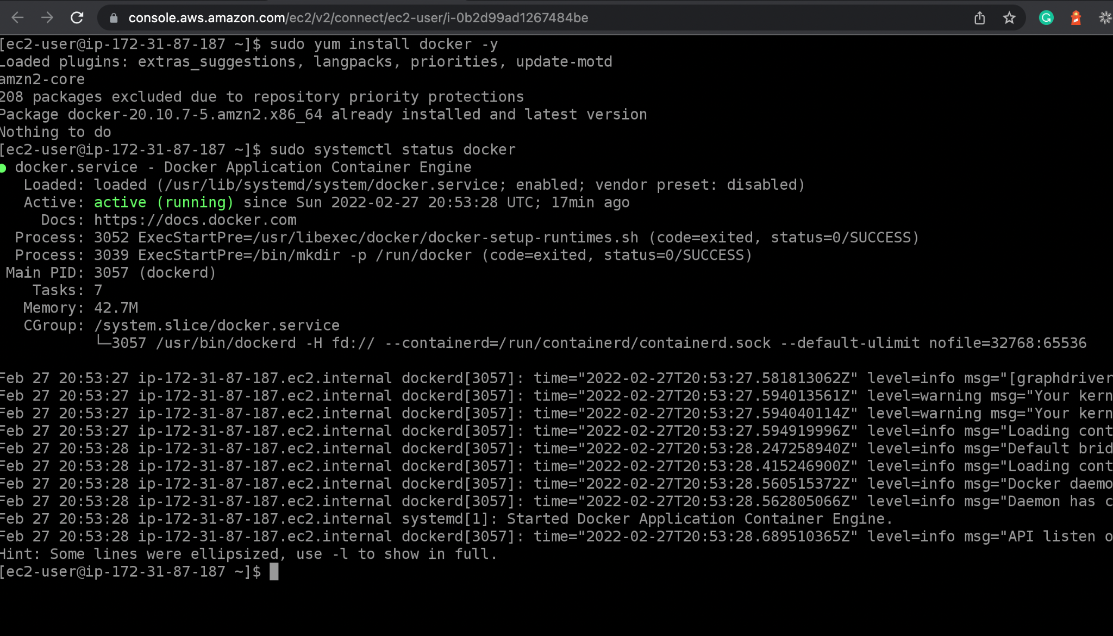
Configure Docker on EC2 Instance
The image below shows the visual of the commands:

Slide 26
Configure Jenkins on EC2 Instance
To configure Jenkins on EC2 instance, install Java first. Use the following commands:
1
Install JDK 8:
sudo yum update -y
sudo yum install java-1.8.0-openjdk
2
# Install JDK 11 – java:
sudo amazon-linux-extras install java-openjdk11
3
# Install JDK 11 Development – javac:
sudo yum install java-11-openjdk-devel
Notes:
To configure Jenkins on EC2 instance, first install Java. Use the following commands:
# Install JDK 8
sudo yum update -y
sudo yum install java-1.8.0-openjdk
# Install JDK 11 - java
sudo amazon-linux-extras install java-openjdk11
# Install JDK 11 Development - javac
sudo yum install java-11-openjdk-devel

Slide 27
Configure Jenkins on EC2 Instance
4
Configure Java Version 8 or 11:
sudo alternatives --config java
5
Read OS name:
cat /etc/os-release
Notes:
# Configure Java Version 8 or 11
sudo alternatives --config java
# Read OS name
cat /etc/os-release

Slide 28
Configure Jenkins on EC2 Instance
6
From Jenkins Installation document follow instructions: [https://www.jenkins.io/doc/book/installing/linux/]
sudo amazon-linux-extras install epel
sudo yum-config-manager --enable epel
sudo yum install daemonize -y
sudo yum install jenkins -y
sudo systemctl daemon-reload
sudo systemctl enable jenkins
sudo systemctl start jenkins
sudo systemctl status jenkins
Notes:
# From Jenkins Installation document follow instructions [https://www.jenkins.io/doc/book/installing/linux/]
sudo amazon-linux-extras install epel
sudo yum-config-manager --enable epel
sudo yum install daemonize -y
sudo yum install jenkins -y
sudo systemctl daemon-reload
sudo systemctl enable jenkins
sudo systemctl start jenkins
sudo systemctl status jenkins

Slide 29
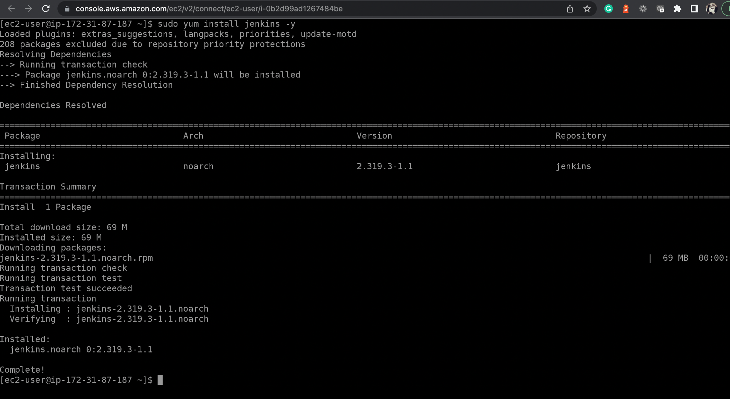
Configure Jenkins on EC2 Instance
Notes:
# Install JDK 8
sudo yum update -y
sudo yum install java-1.8.0-openjdk
# Install JDK 11 - java
sudo amazon-linux-extras install java-openjdk11
# Install JDK 11 Development - javac
sudo yum install java-11-openjdk-devel
# Configure Java Version 8 or 11
sudo alternatives --config java
# Read OS name
cat /etc/os-release
# From Jenkins Installation document follow instructions [https://www.jenkins.io/doc/book/installing/linux/]
sudo amazon-linux-extras install epel
sudo yum-config-manager --enable epel
sudo yum install daemonize -y
sudo yum install jenkins -y
sudo systemctl daemon-reload
sudo systemctl enable jenkins
sudo systemctl start jenkins
sudo systemctl status jenkins

Slide 30
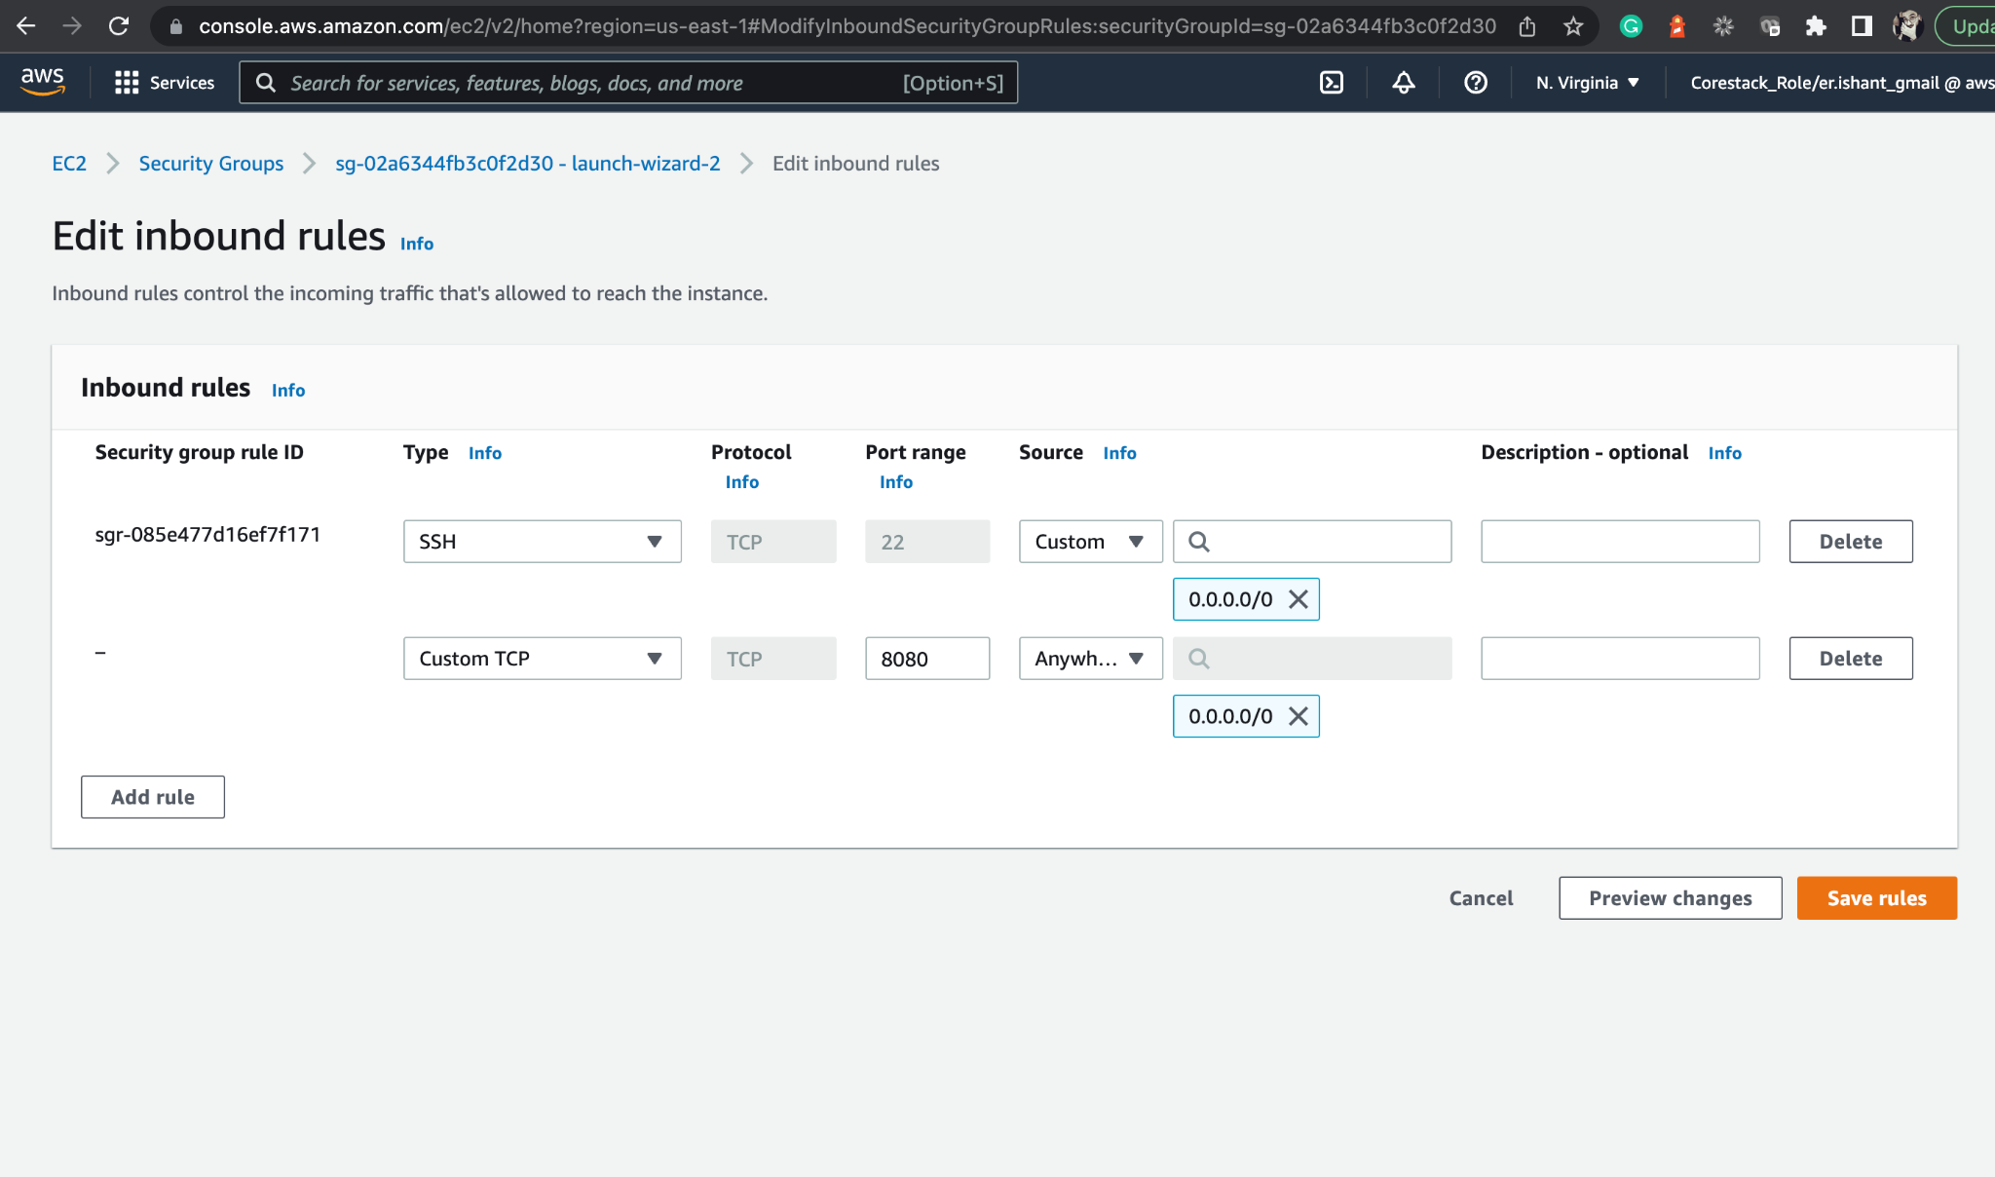
Configure Jenkins on EC2
Edit the Inbound rules of security group associated to EC2 instance
by opening port 8080 so that Jenkins can run.
Notes:
Edit the Inboud rules of security group associated to EC2 instance by opening port 8080 so that Jenkins can run.

Slide 31
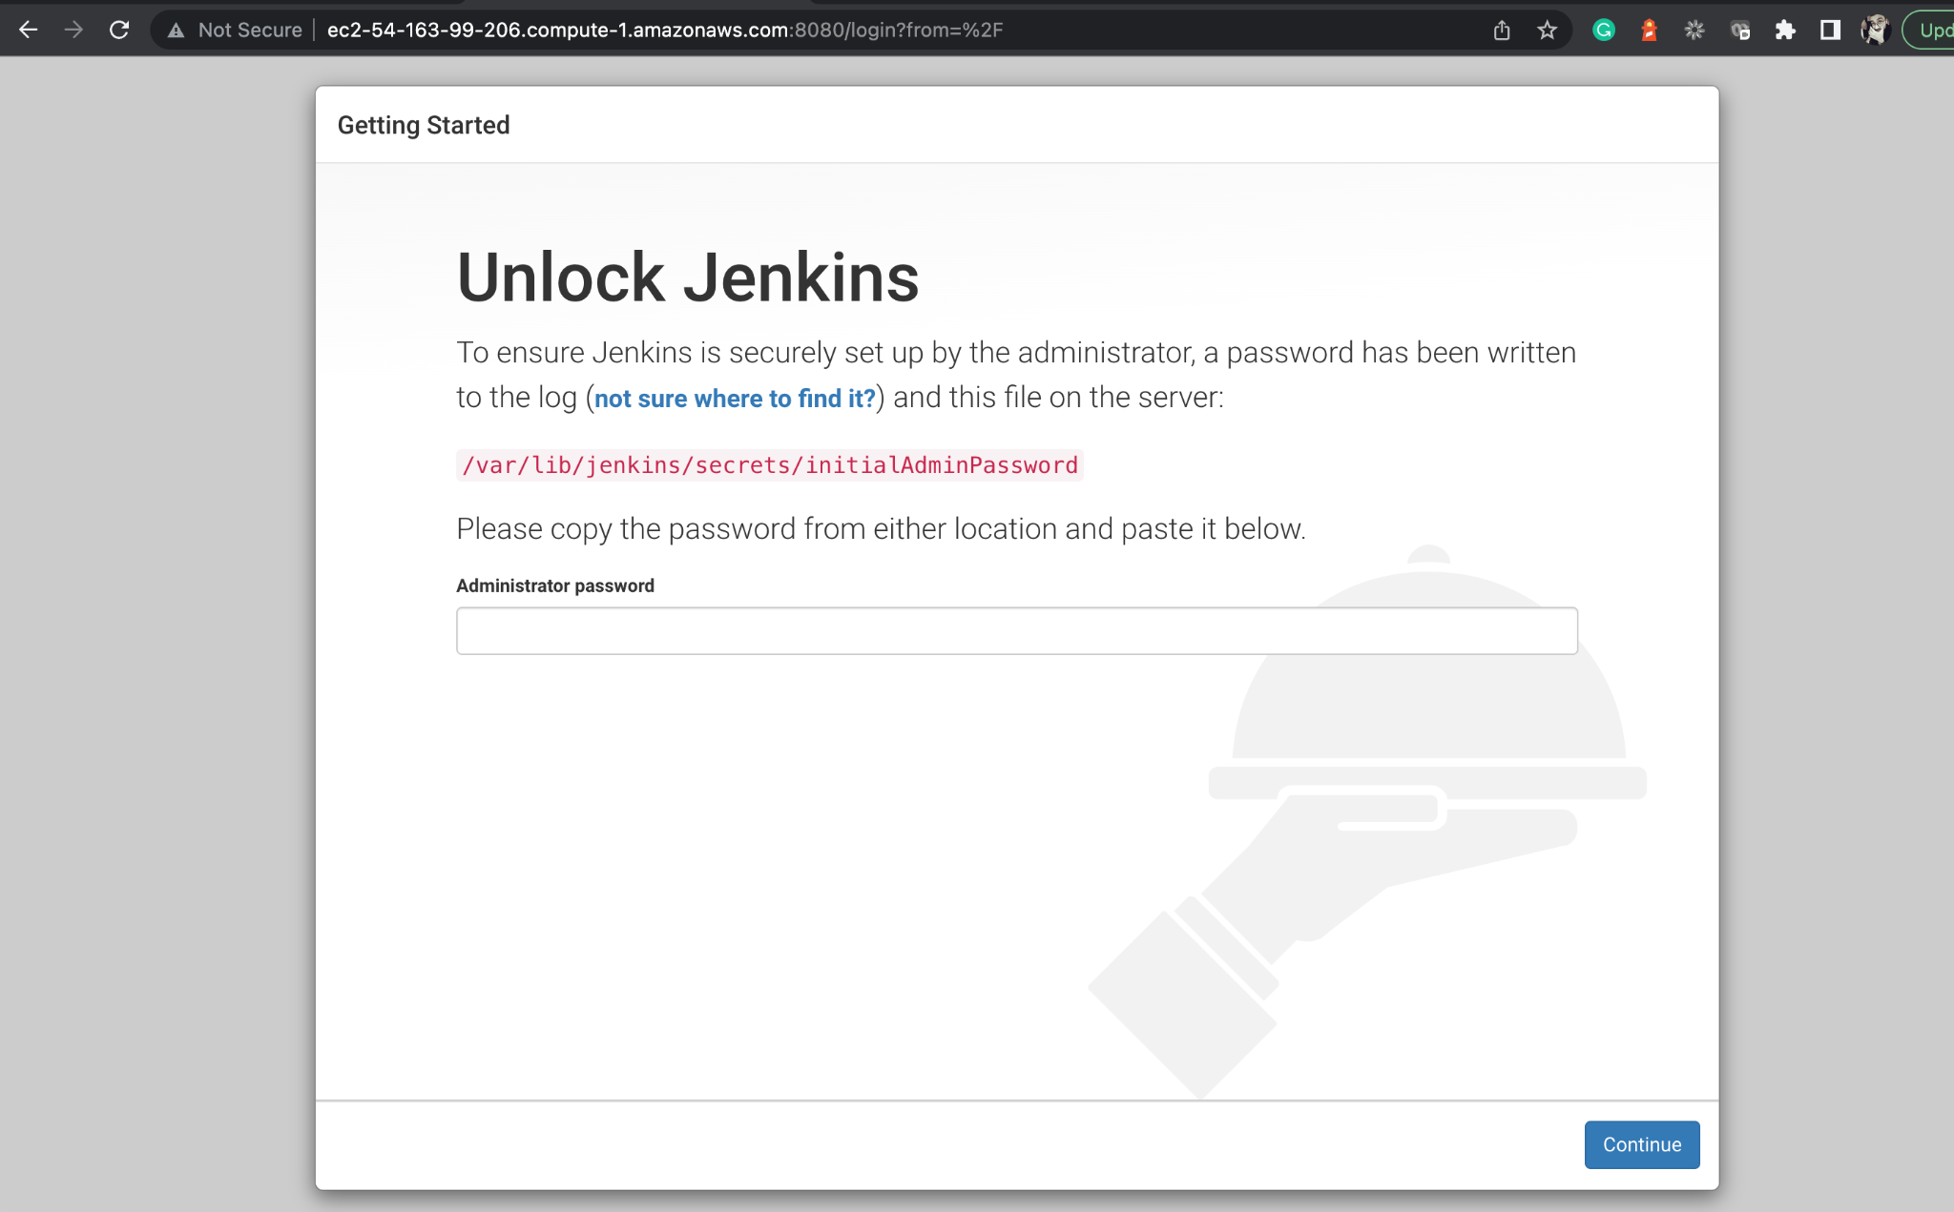
Access Jenkins on Port 8080 of EC2
From here, proceed by logging into the Jenkins with the initial password.
Notes:
From here you can proceed with logging into the jenkins with initial password.

Slide 32
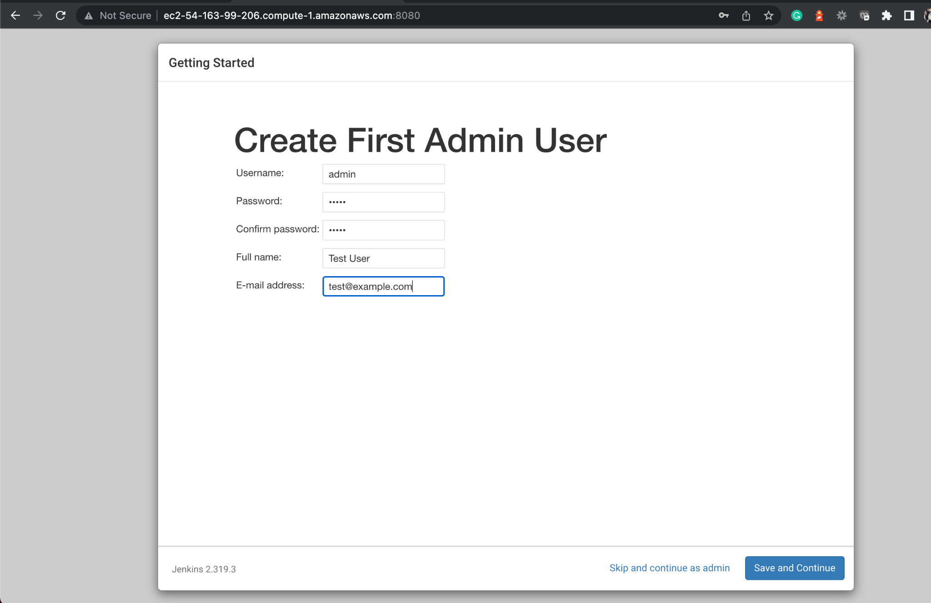
Access Jenkins on Port 8080 of EC2
Create a new user.
Notes:
Create a new user.

Slide 33
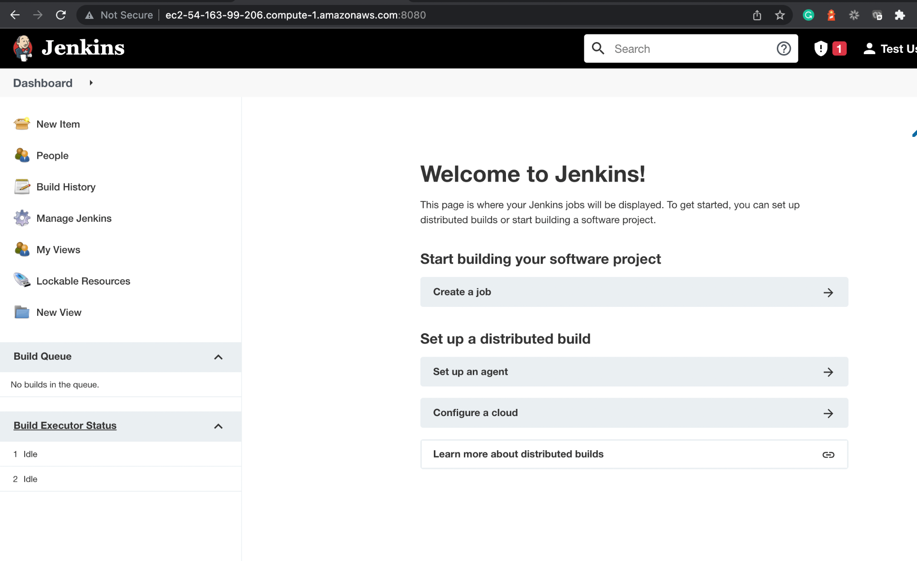
Configure Jenkins on EC2
Jenkins is ready to be used on EC2 now.
Notes:
Jenkins is ready to be used on EC2 now.

Slide 34
Create AWS MySQL RDS Instance

Slide 35
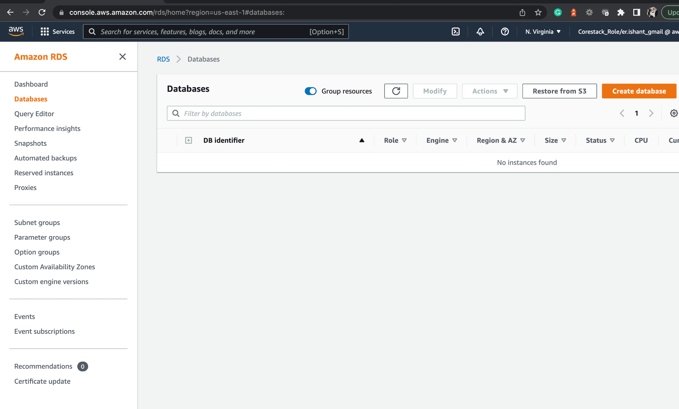
Create MySQL Database
From the Amazon RDS, click on the Create database button.
Notes:
From the Amazon RDS, click on Create database button.

Slide 36
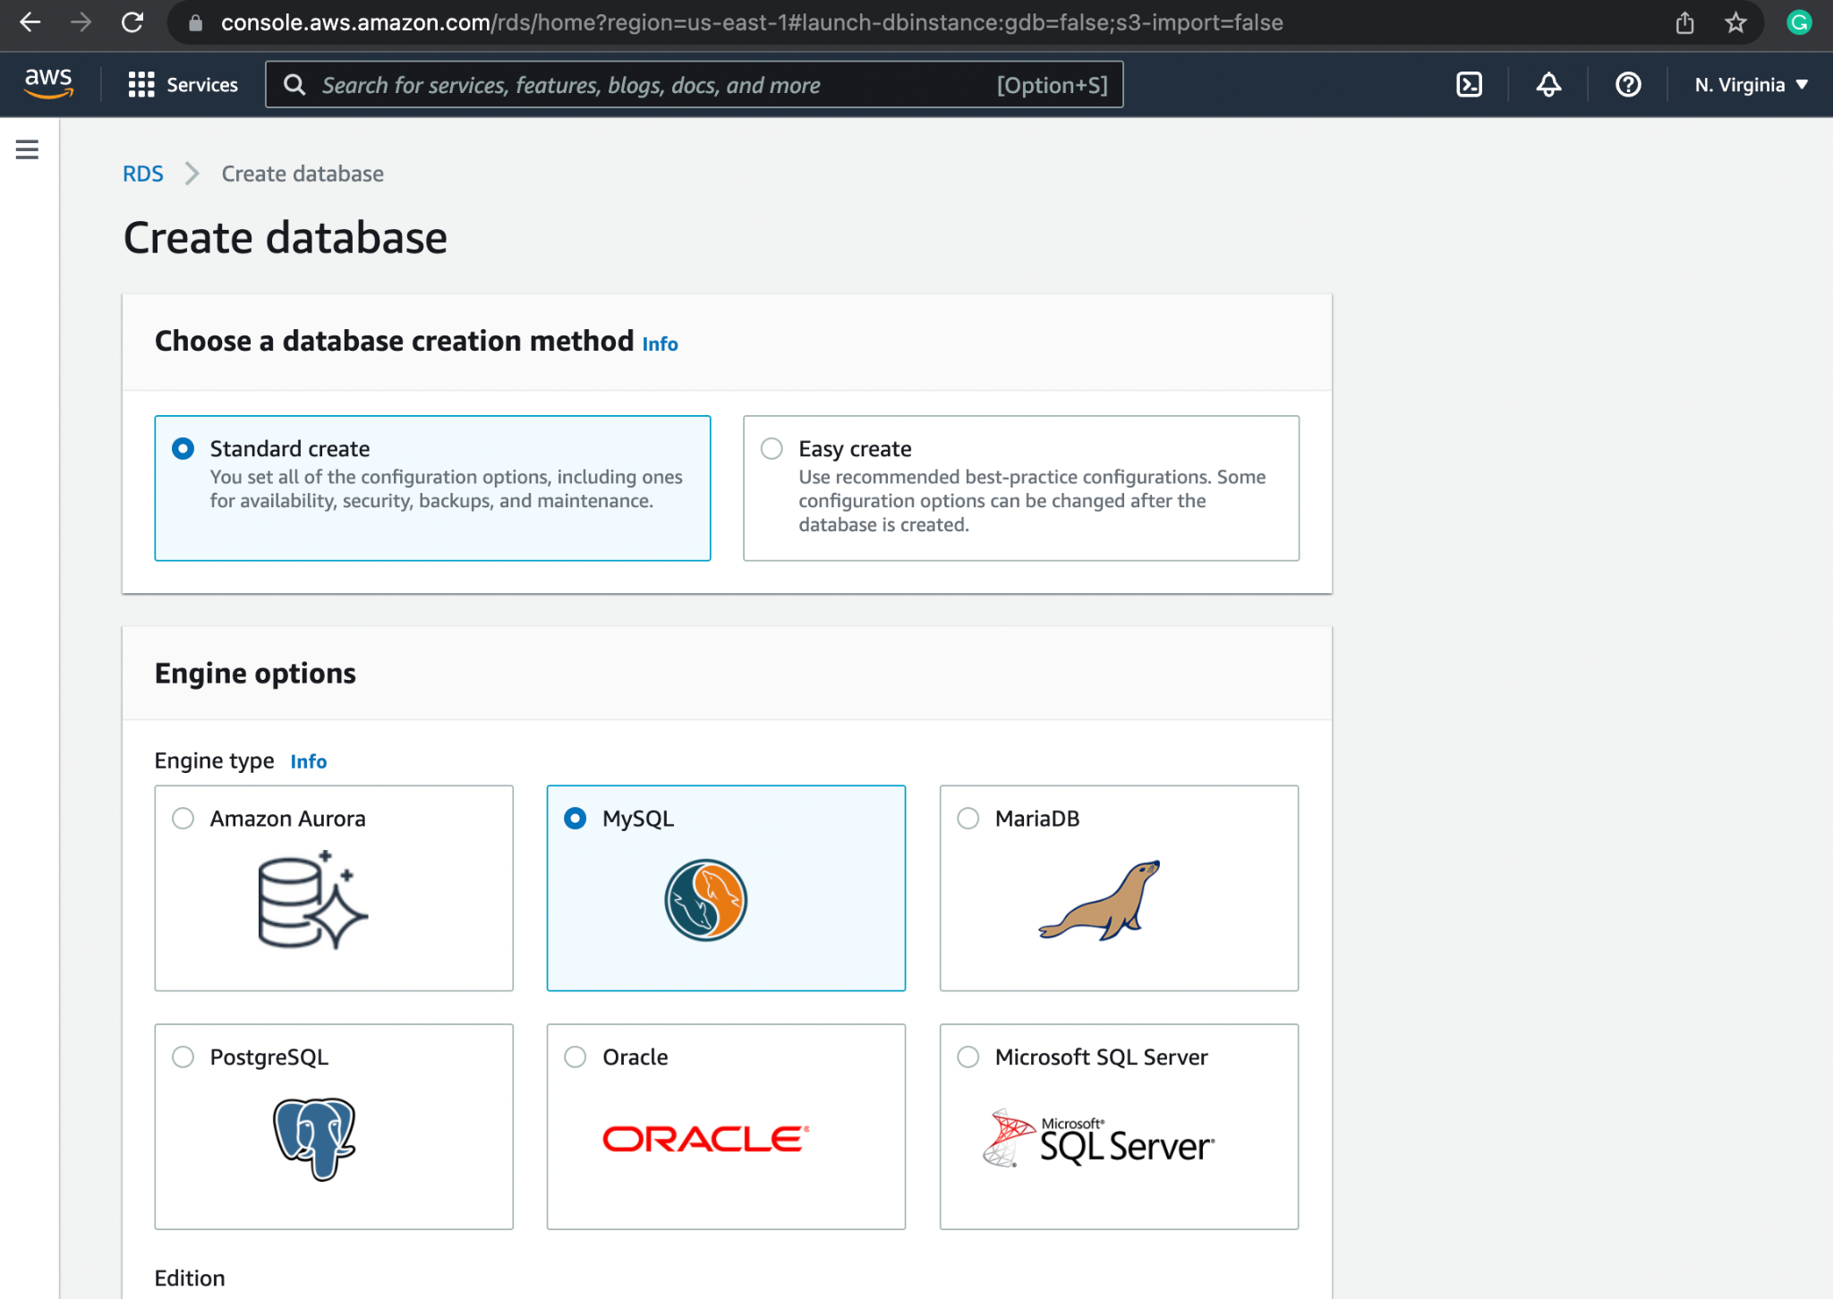
Create MySQL Database
Choose MySQL from the database selection.
Notes:
Choose MySQL from the database selection.

Slide 37
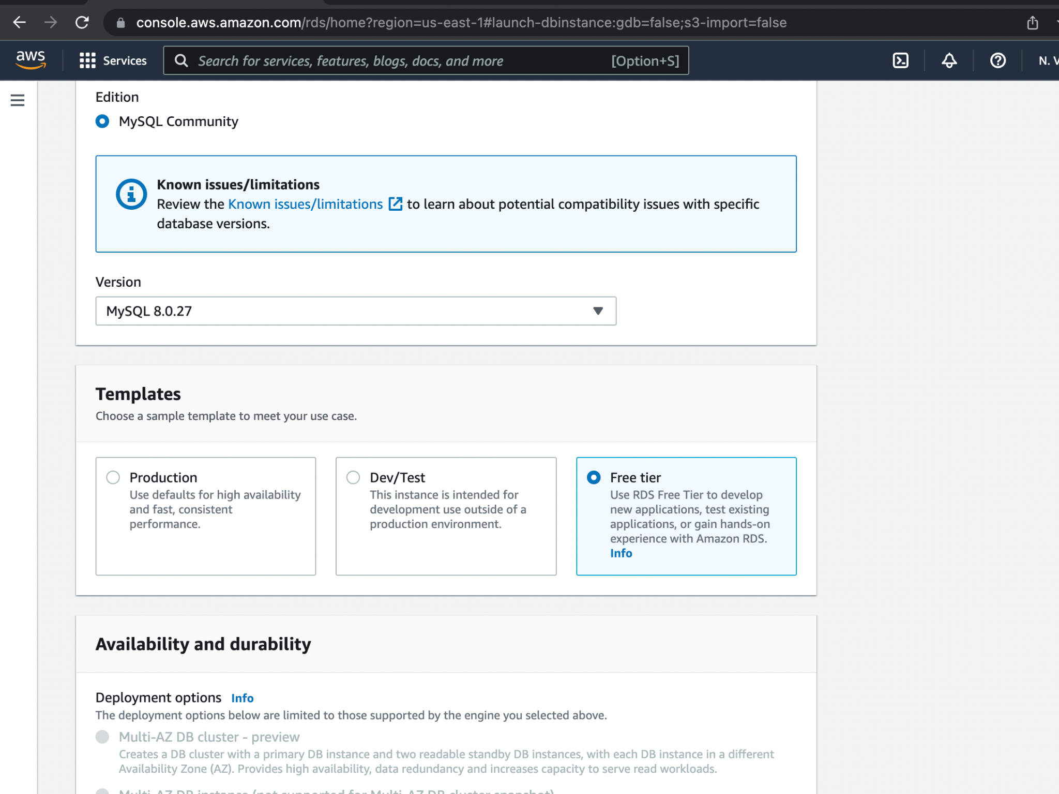
Create MySQL Database
From Templates, select the Free tier option.
Notes:
From Templates, select the Free tier option.

Slide 38
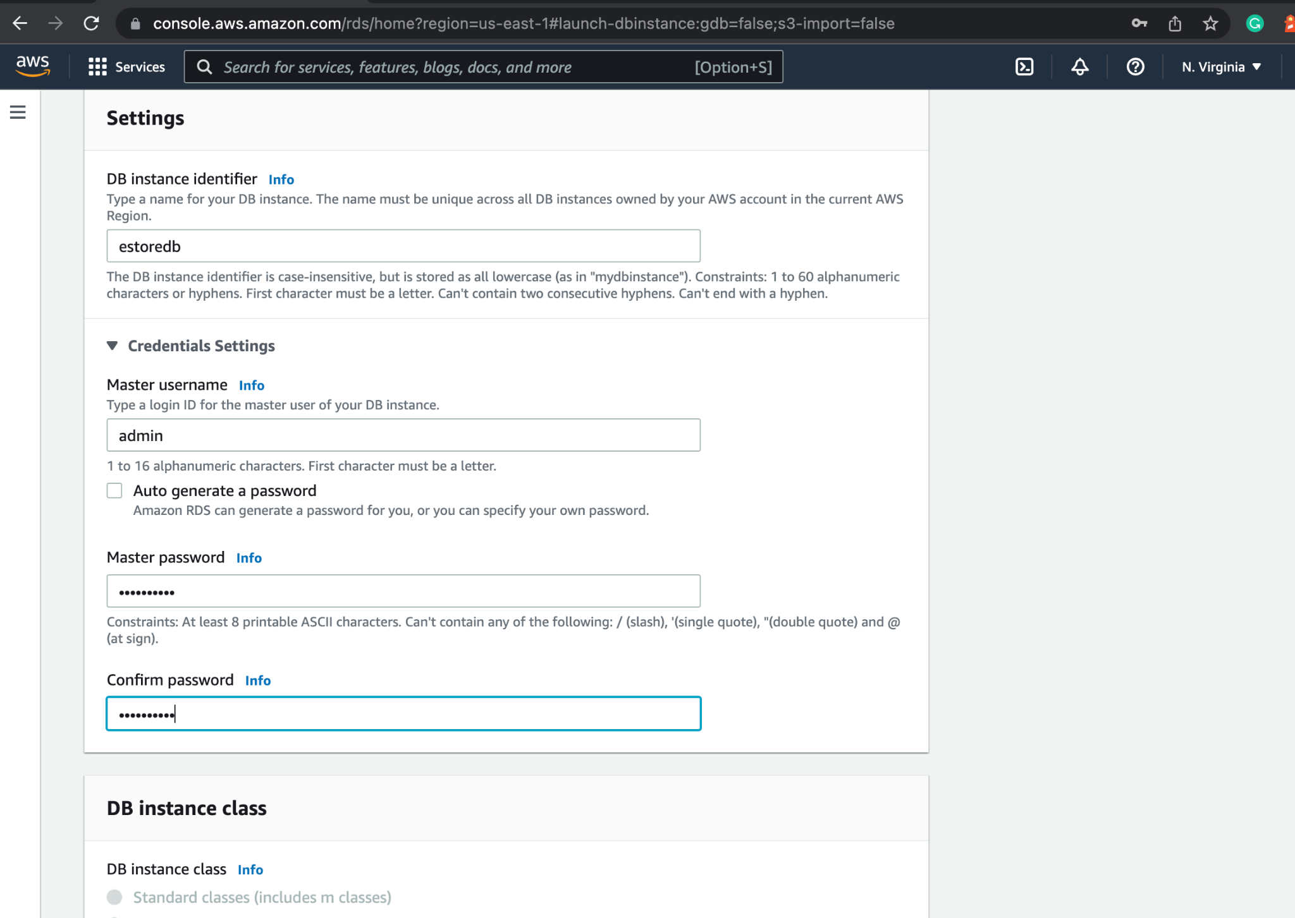
Create MySQL Database
In the settings, provide a name, username, and password for the database.
Notes:
In the setting give a name, username and password for the database.

Slide 39
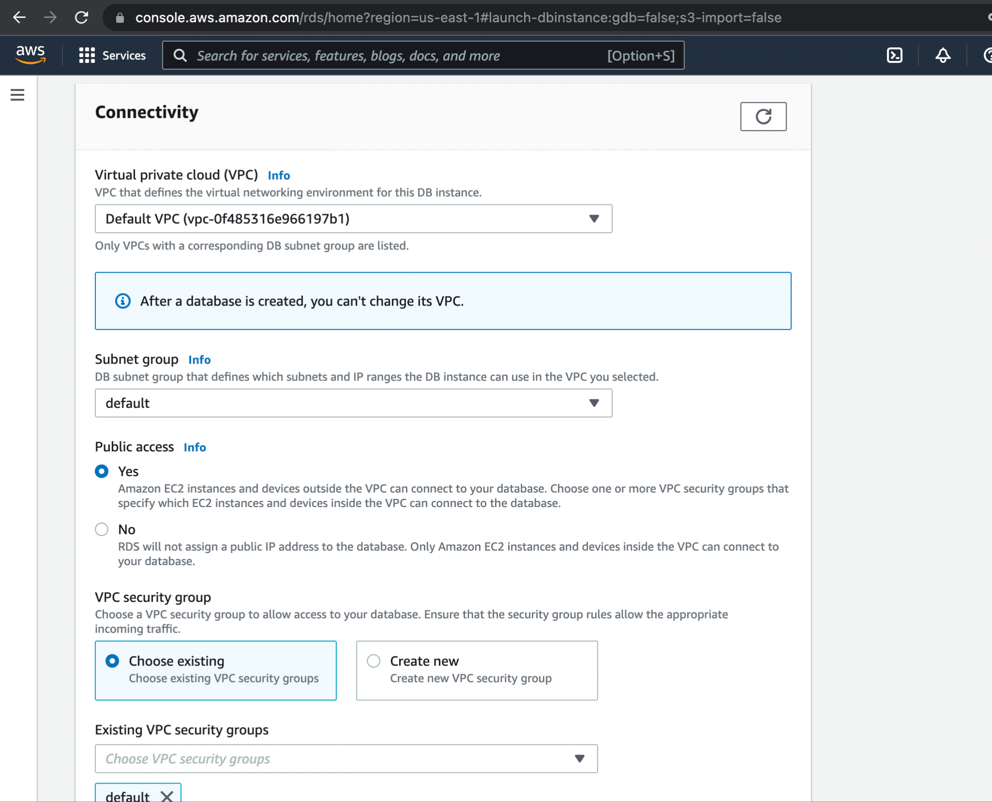
Create MySQL Database
On the Connectivity page, in the Public access section, select Yes and create the database.
Notes:
On the Connectivity page, in the Public access section, select Yes, and create the database.

Slide 40
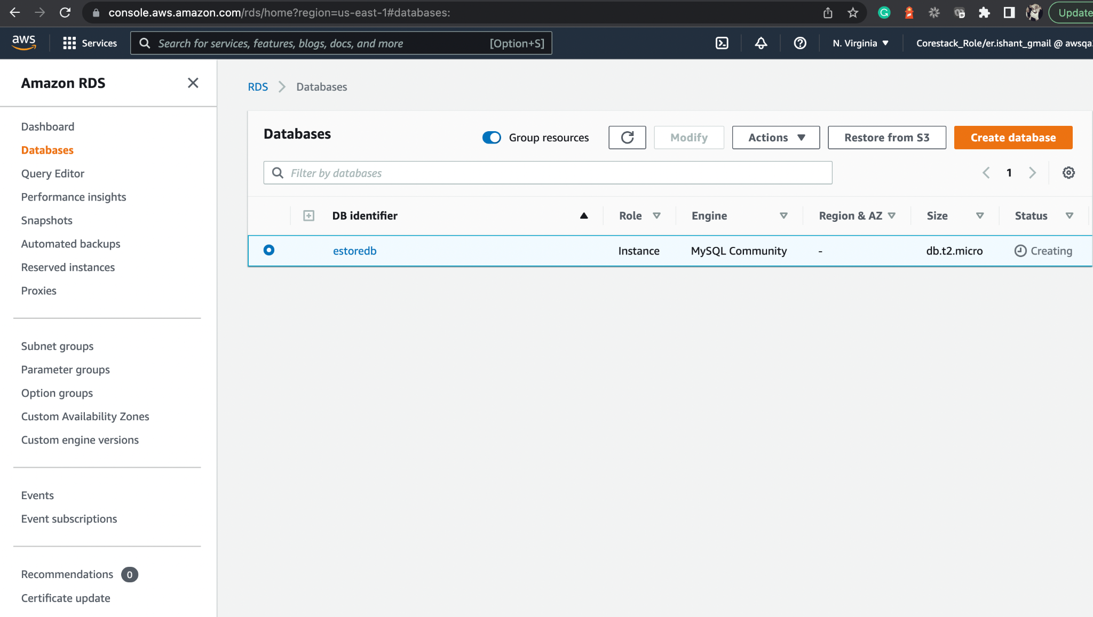
Create MySQL Database
The database is ready.
Notes:
The database is ready.

Slide 41
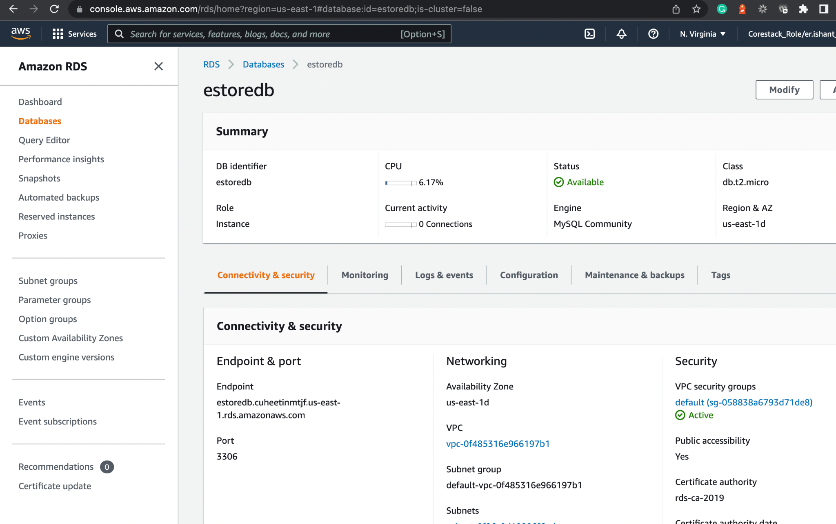
Create MySQL Database
Click the Connectivity & security tab to note the end point and port numbers.
Use the same numbers in the application.properties file of your Java back-end project.
Do not forget to connect to MySQL and create the estoredb database manually.
Notes:
Click the Connectivity & security tab to note the end point and port numbers.
Use the same numbers in the application.properties file of your java back end project.
Also, do not forget to connect to MySQL and create the estoredb database manually.

Slide 42
Build and Deploy with Jenkins Docker

Slide 43
Set Up Jenkins for the Java Backend Project
Notes:
For Java back end, let us set up the Pipeline project in Jenkins.

Slide 44
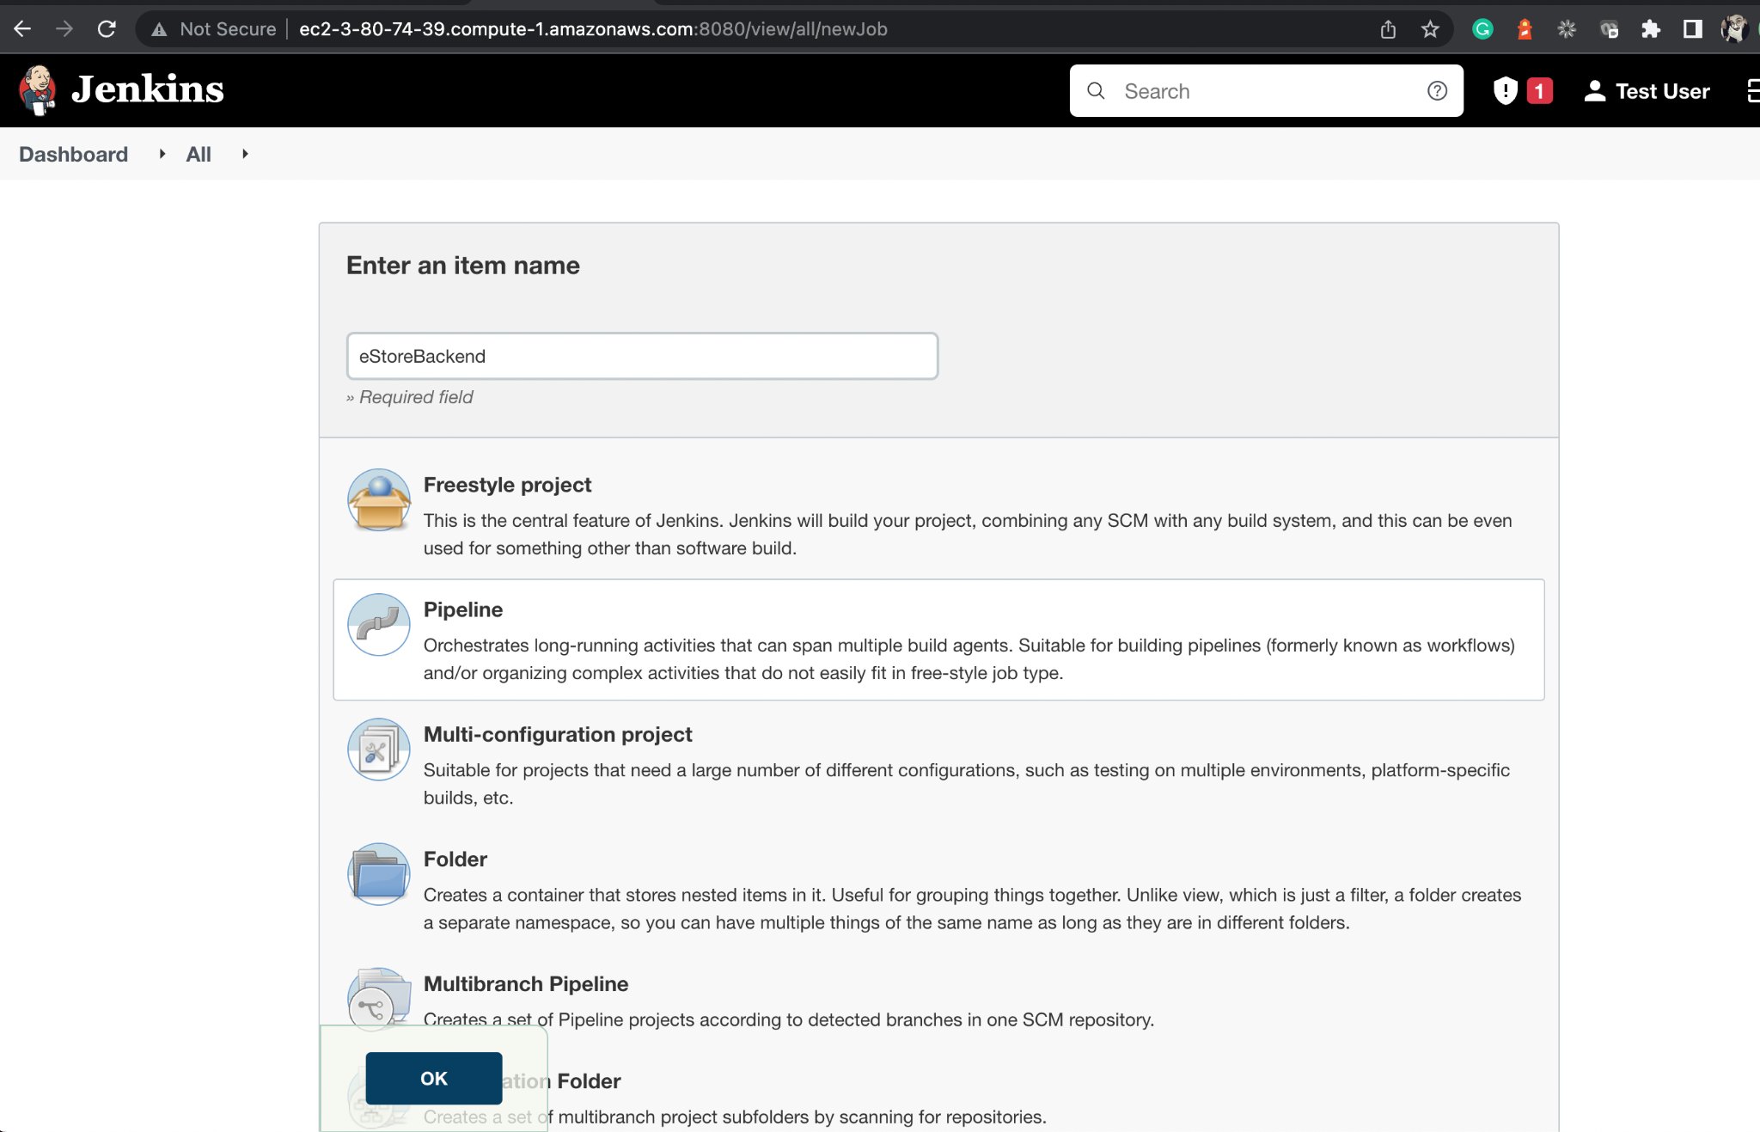
Create a Jenkins Pipeline Project for the Java Backend Project
Create a new project in Jenkins of type Pipeline.
Notes:
Create a new project in Jenkins of type Pipeline.

Slide 45
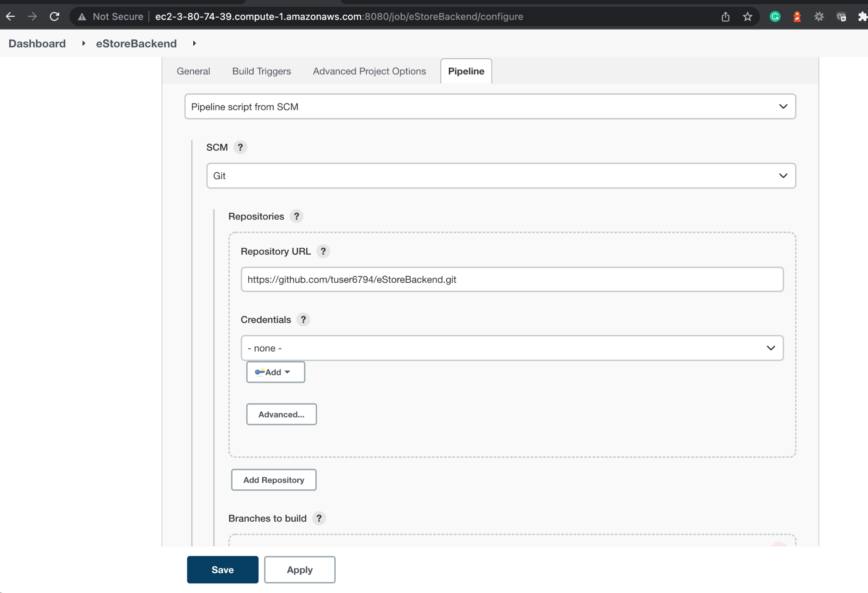
Create a Jenkins Pipeline Project for the Java Backend Project
Configure the Jenkins Pipeline Project by passing GitHub repository URL.
Notes:
Configure the Jenkins Pipeline Project by passing GitHub Repository URL.

Slide 46
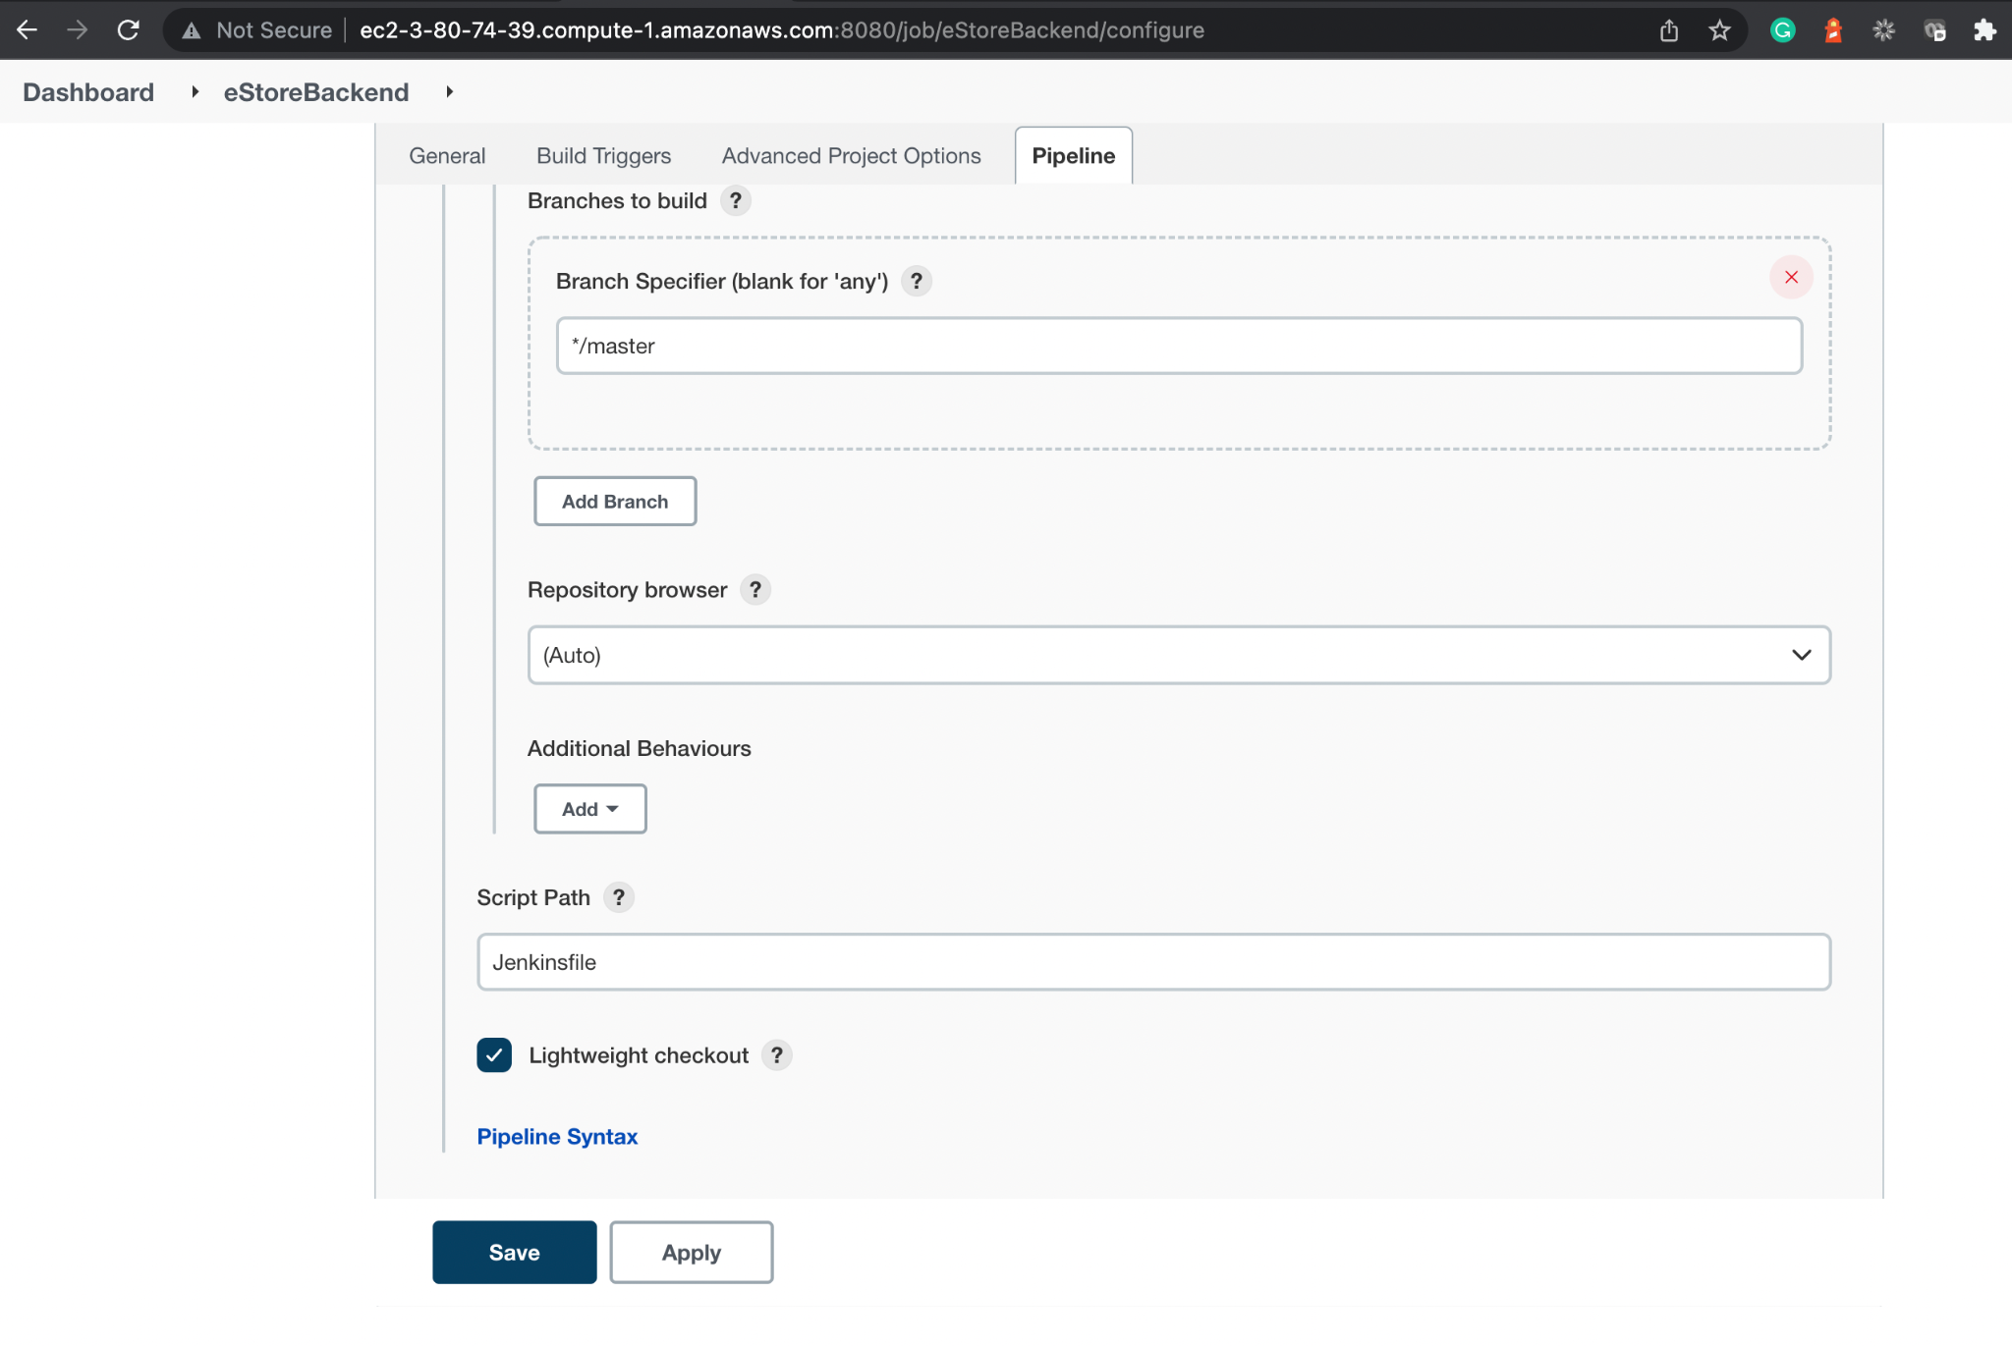
Create a Jenkins Pipeline Project for the Java Backend Project
From the branch specifier, select the default branch, which is master. The Script Path contains the Jenkinsfile, which is created in the root directory of our project.
Notes:
From the branch specifier, select the default branch, which is master.
The Script Path contains the Jenkinsfile which is created in the root directory of our project.

Slide 47
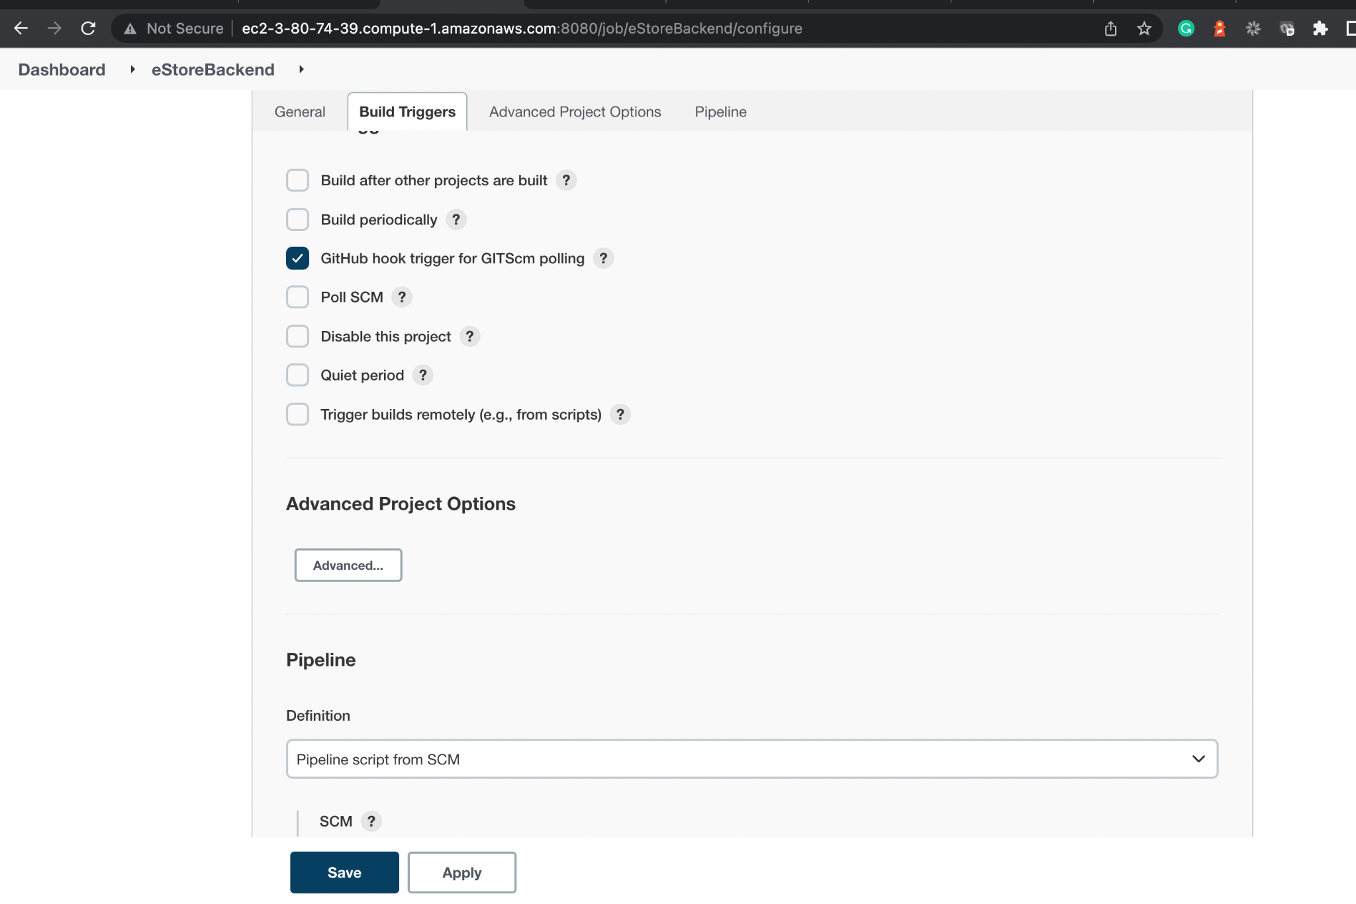
Optional: GitHub Hook Trigger for the Java Backend Project
Configure GitHub trigger for GITScm Polling. Users can configure the same using ngrok.
Notes:
Optional Step
Configure GitHub trigger for GITScm Polling. This option will work when Jenkins is running with a proper URL instead of the localhost.
You can configure the same using ngrok.

Slide 48
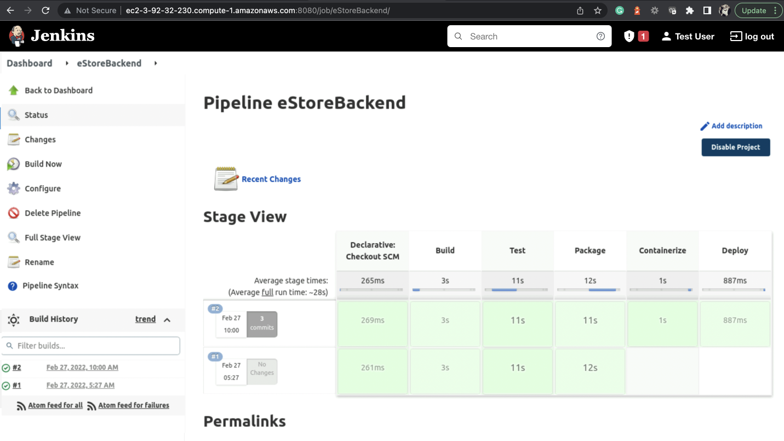
Run the Jenkins Pipeline Project for the Java Backend Project
Notice stages appearing as mentioned in the Jenkinsfile.
Source > Test > Build > Containerize > Deploy
Click on Build Now and build project.
Notes:
Now, click on Build Now and build your project
You will notice the stages appearing as we mentioned in the Jenkinsfile
Source > Test > Build > Containerize > Deploy

Slide 49
EC2 instances is created and configured on AWS.
MySQL RDS database is created on AWS.
Jenkins Pipeline is built to dockerize the Java backend.
Docker is integrated in Jenkins to build and release the images as containers on EC2.

Slide 51
Which command can be used to configure Java versions?
01
sudo alternatives –config java
sudo –config java
sudo java –-config
none of the above

Slide 52
Which command can be used to configure Java versions?
01
sudo alternatives –config java
sudo –config java
sudo java –-config
none of the above
A
In case you have multiple versions of Java, you can choose which one to work with as default sudo alternatives –
config java command.

Slide 53
How can you enable Docker after installation?
02
sudo systemctl docker enable
sudo systemctl enable docker
sudo enable docker
sudo docker enable

Slide 54
How can you enable Docker after installation?
02
sudo systemctl docker enable
sudo systemctl enable docker
sudo enable docker
sudo docker enable
B
You can enable Docker after installation using systemctl command.

Slide 55
What needs to be installed before Jenkins?
03
Java
Git
Daemonize
All of the above

Slide 56
What needs to be installed before Jenkins?
03
Java
Git
Daemonize
All of the above
D
For successful installation and working of Jenkins, you need to install Java, Git, and Daemonize.

Slide 57
Where will you find the connection URL string of MySQL in AWS?
04
Monitoring
Configuration
Connectivity and Security
Logs

Slide 58
Where will you find the connection URL string of MySQL in AWS?
04
Monitoring
Configuration
Connectivity and Security
Logs
C
Open Connectivity and Security to get the connection URL string of your database.

Slide 59
In order to connect to MySQL from client, which port number should be opened in security group?
05
8080
3306
22
Any of the above

Slide 60
In order to connect to MySQL from client, which port number should be opened in security group?
05
8080
3306
22
Any of the above
B
You need to open the port 3306, which is the default port for MySQL database.

